Slide 2
Anthrophony
Definition of Anthropology
The word ‘Anthropology’ has been derived from two Greek words-
Anthrop means man &
Logia means study or science
Thus, the etymological meaning of Anthropology is “the study of man”.
C.A Kottak defines “Anthropology” as follows-
“The scientific and humanistic study of the human species. It is the exploration of human diversity in time and space.
Beals and weitz define as -
“The anthropologist combines in one discipline the approaches of both biological and the social sciences”.
Nanda Serena says-
“Anthropology is the comparative study of human kind.”

Slide 3
Types of Anthropology
Anthropology may be broadly divided into two areas-
Physical Anthropology
Cultural Anthropology
Physical Anthropology: Physical Anthropology mainly focuses on biological aspects of human being. Physical anthropology links to other fields: - Biology, Zoology, Geology, Physiology, Anatomy and Medicine.
Physical anthropology has several specialized areas. This are-
Evolutionary Biology: It discusses about human evolution. It can be divided into two types-
Paleontology- The study of the buried fossils of human and related animals.
Primatology- The study of the similarities and differences among the primates, namely, tree shrews, lemurs, and lorises, tarsiers- monkeys, apes and human.

Slide 4
Types of Anthropology
Human Biology: It is the study of human variation. It has several branches-such as: human genetics, skeletal biology & human adaptability.
Human Morphology: The scientific study of the form and structure of human body without consideration of function.
Anthropometry: Anthropometry is a comparative study of the human body. These techniques are used to measure the absolute and relative variability in size and shape of human body.

Slide 5
Cultural Anthropology
Cultural Anthropology is the study of human society and culture, the subfield that describes, analyzes interprets and explains social and cultural similarities and differences.
Cultural Anthropology may be subdivided into three main branches-
Ethnology
Archaeology
Linguistic
Ethnology: Ethnology is the scientific study and Comparison of human culture. Ethnology is concerned with patterns of thought and behavior such as: - marriage, customs, kinship, organization, political and economic systems, religion, folk art and music.
Archaeology: Archaeology is the study of past cultures. Anthropological archaeologists are usually concerned with what are called prehistoric cultures.

Slide 6
Linguistic: The transmission of culture from generation to generation is made possible by language, which enables us to preserve the traditions of the past and to make provisions for the future.
In anthropological approach, linguistics can be divided into several types—
Descriptive or Structural linguistics– deals with the characteristics sound unit employed in a language and its grammatical system.
Historical linguistics– deals with changes in language overtime, including sound shifts & the influence of one language on another.
Cognitive Anthropology– It is can concerned with the ways in which the speaker of a particular language classify and conceptualize phenomena.

Slide 7
Origin of the word Bengal or bangla
The exact origin of the word bengal or ‘bangla’ is unknown, though it is believed to be derived from the dravidian speaking tribe ‘bong’ that settled in this area. Ghulam hossain salim mentioned in his ‘riad-al-salatin’ that this tribe lived in this area on approximately 7500 years ago.
Other accounts speculate that the name is derived from vanga
( bonga),which came from the austric word ‘bonga’ means sun god.
According to mahabharat, purana,harivangsha vanga was the adopted son of the king vali who founded the vanga kingdom.
The muslim accounts refer teht ‘bong’ a son of king hind colonized the area first.

Slide 8
Origin of the word Bengal or bangla
Linguists believe that the name originated from the Tibetan word ‘bans’ which means wet and moist. Bangla is a wet country crisscrossed by a thousand rivers and monsoons and floods from the Himalayas.
Some other believe that the name originated from the assumes word ‘Bodo’ which means wide plains.
The earliest reference ‘vangala’ has been traced in the nesari plate (805A.D.) of dharmapala, the king of vangala.
Shams-ud-din iilyas shah took the title ‘shah-e-bangala’ and united the whole region under one government for the first time.

Slide 9
Peoples of Bengal Anthropological Background
It is very difficult to say with certainty when human settlement in bengal started. There are also controversy over the origin of the people of bangladesh.
The reconstruction of the history of Bengal in the pre-Muslim period is difficult due to paucity of sources. The difficulty is felt more acutely for the earlier period, down to the 4th century AD, when Bengal came under the Imperial Guptas. For this period we have to depend on very scanty references in the Vedic, Epic and Puranic literature as well as on the available archaeological evidence. From the Gupta period onwards we get written records in the form of epigraphs and literature which contain information on the history of the 'region' of Bengal.
Ghulam husain salim mentioned in his riyad al salatin that nearly seven thousand and five hundred years ago ‘bang’ tribe set up their residence in Bengal.

Slide 10
Peoples of Bengal Anthropological Background
The anthropological background of Bengali people rooted down in two distinctive groups(based on the ethnic language)-
Dravidians: Some scholars assume that people came and settled in Bengal (Bangladesh, West Bengal) ten thousand or more years ago. Those people were the non-Aryan ethnic groups – Nisadas or Austro-Asiatics or Austric who are now represented by the peoples known as Kola, Bhil, Santal, Shabara, Pulinda etc. Different groups of people settled in different areas in Bengal and the name of the areas were associated with the groups settled in that area. There were 16 ancient Janapadas, such as: Vanga, Pundra, Radha, Gauda, Harikela, Samatata, Magadha etc. These people altogether described as Dravidians.

Slide 11
Peoples of Bengal Anthropological Background
Aryans: It is very difficult to say about the time of arrival of Aryans and their expansion in Bengal, but it can be said that though the Aryans entered Indian sub-continent nearly three thousand five hundred years (1500B.C.),They came to Bangla very late, probably about 5th century B.C. The Aryans entered Bengal as fighters, traders and preachers of religion. As a result a new force was introduced in Bengal. The Aryan language, religion, social practices and other elements of culture was establish. The non Vedic language disappeared and the vedic, puranic religion, buddhism and jainism spread in Bengal. The extension of Gupta empire confirmed this process of the establishment of aryanism in Bengal.

Slide 12
Background of the People:
In order to know the anthropological background of the people of this soil, we have to analyze the ethnic or racial background of our people. So far Anthropologists have discovered four major races of mankind. They are as follows:
Caucasoid
Australoid
Skin color | White
Nose | Narrow and pointed
Lip | Thin
Stature and cephalic index | Extremely varied
Nordic, Alpine, Mediterranean, Europeans etc.
Skin color | Black
Hair | Thick and heavy
Brow ridge | Pronounced
Arms & Legs | Long and spindly
Aborigines of Australia

Slide 13
Mongoloid
Skin color | Brownish to yellow
Hair | Black and straight
Body Hair | Noticeably sparse
Nose | Flat
Chinese, Korean, Japanese etc.
Negroid
Skin color | Chocolate to jet black
Hair | Woolly or frizzy
Nose | Small
Ears | Bulbous
Lips | Bulbous
Jaw | Heavy
All Africans except North Africans and inhabitants of North Sahara.

Slide 14
Racial Characteristics of the people of Bangladesh
Proto-Australoid were the original inhabitants of Bangladesh.
The diversified Characteristics were seen among the Bengali Population.
They belonged to the Dravidian language speaking groups.
Stature | Short and middle structure
Size of the Skull | Long and round
Skin color | Black
Nose | Wide

Slide 15
There are Caucasoid, Mongoloid influence and Ausraloid influence on Bengali people,
therefore, the Bengalis are a mixed race.
During the period between 8th and 12th century, Muslim saints and Muslim traders came here from Turkey, Iran, and from other countries of central Asia. The Muslim saints came to preach Islam and the traders came with an ambition of trading here. Many of these people ultimately settled here permanently and also got married here. So, there is a great influence of the Muslims on the people of the Bengal.
According to Hunter, the Muslims of this country are converted Hindus and Buddha.
Finally, we can say that the original inhabitants of this country were by and Australoids influenced by Caucasoid and Mongoloid race. They did not belong to any major race of mankind but they were a mixed race.

Slide 16
Language:
Language and community are intimately linked. Bengal in the pre-Vedic period was supposed to be dominated by the people of Austric linguistic groups. This language is also known as Dravidian language. All their languages belonged to the language family of Austric. We may assume that Bengal in pre Aryan period had non Aryan speakers and there were a large number of Austro-Asiatic Mundary speakers, some of them are known as Munda, Santal, Ho, Bhumij, Mahali, Birhor, Turi and Kora at present. The word ‘Banga’ seems to be of Austro-Asiatic origin.
This was however replaced by Sanskrit language. Prakrit-Sanskrit language was greatly influenced by Austric language. Sanskrit borrowed many words and grammatical rules from Austric language. Many language of the present Indian subcontinent originated from sanskrit language. Almost all the languages of India and Bangladesh belong to the Sanskrit languages family. Bengali language had its origin in Sanskrit.

Slide 17
Present People
Nationality:
Major ethnic: Bengali
Minor ethnic: Santhals, Chakma, Garos (Achiks), Oraons, Mundas, Mro,Tanchangya,Tripura,Monipuri,Khashia, Kaibarta, Marma, Meitei, Zomi, Bihari(Stranded Pakistani)
They are diversed ethnic communities including Australoid, Tibeto-Burman and Sino-Tibetian races.
Religion:
Muslim 89.5%, Hindu 9.6%, other 0.9% (2004) About 89% of Bangladeshis is Muslims, followed by Hindus (8%), Buddhists (1%) and Christians (0.5%).

Slide 18
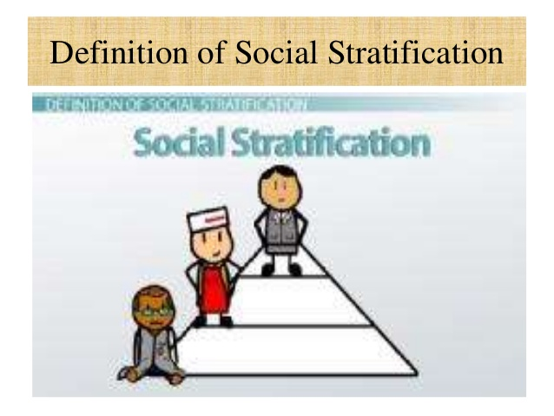
Social Stratification
Definition of Social Stratification
The unequal distribution of goods and services, rights and obligations, power and prestige
Social stratification is structured inequality between groups. This inequality may be based on economics, gender, race, religion, age, or another factor.
A system by which a society ranks categories of people in a hierarchy.
Basis of Social Stratification
Physical appearance, ethnicity, profession, family background, gender, ideology, age or skill in economic/political roles.

Slide 19
Types of Stratification Systems
Estate - Elite owns property and has control over resources.
Caste - Rigid hierarchy of classes.
Class - Status is partially achieved, there is some potential for movement between classes.
Upper class – the elite with great wealth who own the “means of production”, or who otherwise dominate the economic system
Middle class – professionals with high paying jobs in respected occupations (upper-middle class), and the skilled who work in moderately compensated occupations, and who own few assets (lower-middle class).
Lower Class- Lower class people don’t have access in resources, wealth as well as power.

Slide 20
Dimensions of Social Inequality (stratification)
Power—control resources in one’s own interest.
The ability to control the behavior of others, with or without their consent based on force, possession of special skills, knowledge, social status, personal characteristics, and custom/tradition
Wealth—accumulation of material resources or access to production.
Made up of assets (value of everything one owns) and income (money earned through salaries, investments, or capital gains
Prestige—social honor or respect.
Respect, honor, recognition, or courtesy an individual receives from other members of society based on income, occupation, education, family, residences, possessions, club memberships .

Slide 21
Stratification & status
Type of status
Ascribed status - social positions that people hold by virtue of birth
As for example-Race, Sex, Age, Ethnicity, Physical Characteristics, Caste.
Achieved status - social positions attained as a result of individual action e.g.
Occupation, Education, Social class.
Caste System
System of stratification In Hindu society is based on birth. Five caste categories
Brahmins - priests and scholars
Kshatriyas - ruling and warrior caste
Vaisyas - the merchants
Shudras - menial workers and artisans
Harijans – “untouchables”

Slide 22
Among Muslim society we can see two types of social strata-
Ashraf- the people whose ancestors were immigrant Muslims, are called Ashraf and they are treated as more respected.
Atraf- The people whose ancestors were converted Muslims are called Atraf.
Social Stratification in Bangladesh Context
Since the dawn of civilization it is almost a common feature of rural society that it is and was divided into many classes. Rural society in Bangladesh has also its own class formation in terms of
Amount of land
Economic Strength & Occupation
Authority, Coerce & Politics
Religion, Status, Caste etc.
Education, Information and Knowledge

Slide 23
Bangladesh is a small country situated at the north-eastern part of South Asia. It lays between 20⁰34′ and 26⁰38′ north latitudes and between 88⁰01′ and 92⁰41′ east longitudes.
It is bounded on the West by West Bengal, on the north by West Bengal and Meghalaya, on the East by Assam, Tripura and Myanmar and on the South by Bay of Bengal.

Slide 24
Geographical Location of Bangladesh
Bangladesh is a densely-populated, low-lying, mainly riverine country located in South Asia with a coastline of 580 km (360 mi) on the northern part of the Bay of Bengal. The delta plain of the Ganges (Padma), Brahmaputra (Jamuna), and Meghna Rivers and their tributaries occupy 79 percent of the country.
The cultural history of Bangladesh has evolved from the operation of several forces and elements. Of those the basic force is perhaps geography. Hence for a proper understanding of the cultural history of Bangladesh it is necessary to have a glimpse of geographical and environmental aspects.

Slide 25
Area and boundaries
Area: total: 148,460 km² country comparison to the world: 95 land: 130,170 km² water: 18290 km²
Land boundaries: total: 4,413 km border countries: Myanmar 271 km, India 4,142 km
Coastline: 580 km
Land use: Arable land: 73% Permanent crops: 2% Permanent pastures: 5% Forests and woodland: 15% other: 5% (1993 est.)

Slide 26
What is Physiography
Physiography is the holistic discussion of the earth and its characteristics.
Physiography is the terrain condition of a tract of land.
It reveals the condition of the surface of land. It deals about the total feature of the crust.
The physiography may vary from place to place.

Slide 27
Physiographic features of Bangladesh
Bangladesh is a low lying and vast plenty area. Its physiographic feature is much diversified. It is mentionable here that the physiographic feature of an area may change in pace of time due to natural and artificial cause.
Physiographic Classification
1.Tertiary Hills
2. Pleistocene Hills
3. Flood Plains

Slide 28
1. Tertiary Hills
developed in Tertiary period (35-15 m yrs ago) occupying 12% of the land area
located mainly in the southeastern regions of Ctg & CHTs and northern part of great Sylhet District.
topography is largely determined by geological structure (folded, faulted & uplifted) & rock type (sandstone, siltstone & shale of mid-Tertiary age).
It is subdivided into three parts-
1.1 Chittagong and Hill Tract Districts
1.2 Hill ranges of northeastern Sylhet District
1.3 Hills along the narrow frontier strip of Sylhet and Mymensingh District.

Slide 29
1.1 Chittagong hill tracks
High north-south striking hill ranges occupy wholly the districts of Chottogram, Cox’s Bazar and the hill track districts. The hills becomes higher towards east reaching a maximum height of 1000m.
The lowest ranges generally follow the eastern coast of the Bay of Bengal from Feni river to Naf river and continue southwards across the Mayanmar border. Most of the Moheskhali Island belongs to this hilly region. There is a narrow strip of coastal plain in the Chottogram District and a very narrow strip of beach from Cox’s Bazar to Teknaf, between the hills and the Bay of Bengal. Chokoria Sundarban and the associated Mud flat area is a small delta of the Matamuhuri river.
Towards the east, the ranges get higher and the slop steeper until they reach the highest hill range in the east that marks the boundary between Bangladesh, Mayanmar and India.

Slide 30
1.2 Hill ranges of Northern Sylhet:
Some of the hill ranges of the Chittagong and the Hill Tract districts continue northward across the Indian State of Tripura and from the hill ranges of northeastern Sylhet region. These hill ranges attain a much lower elevation and slope more gently than their continuation in the Chittagong and the Hill Tract districts.
1.3 Hills along the Narrow strip of Sylhet and Mymensing Districts
The narrow strip of disconnections low hill ranges extends from Jaflong in he east to Bramaputra river in the west. These hills do not form continuous range but constitute a chain of circular and elongated hillocks separated by Holocene alluvial valleys. Along the frontier of greater Mymensing these hills from series of circular and elongated hillocks.

Slide 31
2. The Pleistocene Terrace or The Pleistocene Uplands
2.1. The Barind Tract
The Barind Tract is located in the west of the Brahmaputra River. It covers an area of 7680 sq. km in the Rajshahi division.
The Barind Tract is the product of vertical movements of Pleistocene period and reaches as maximum height of 20 m above modern flood plains.
2.2 The Madhupur Tract
This area of about 4,058 sq. km. extends in Dhaka, Mymensingh and Tangail districts.
In the Madhupur Tract, reddish brown clay deposits are exposed on some north south trending elongated flat landmass abruptly elevated from the surrounding floodplains.
In Madhupur Tract the landmass reaches a maximum height of 17 m from sea level.

Slide 32
2.3. Lalmai Hills
The Lalmai Hills are situated in the Comilla district and are composed of reddish brown clay.
The Lalmai Hills represent a north-south elongated low hill range of about 16 km long and about 2-3 km wide. It covers an area of about 33 sq. km.. The average height is about 12 m
The reddish brown deposits exposed in the Lalmai Hills area is considered as the extension of the reddish brown deposits of the Madhupur area of Pleistocene age.

Slide 33
3. Flood plains
Flood plains are also known as alluvial plains through fluvio-deltaic processes.
flood plains are created due to the deposition (alluvium) of the GBM rivers covering 80% of the land in Bangladesh. It is a plain land which stretches from the Himalayas to the Bay of Bengal. The most significant features of the land is the large network of rivers, big and small khals, lakes(bills), swamps and marshes. Many rivers flow across the plain towards the south. The three main ones are the Padma( ganges),The Jamuna(Brahmaputra) and the Meghna.

Slide 34
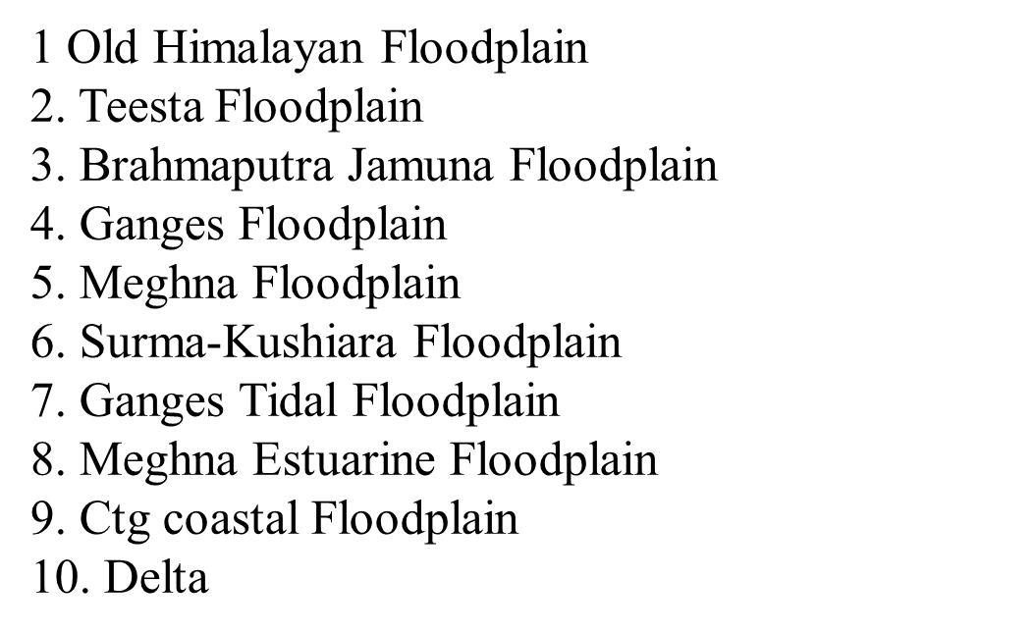
there are as many as 10 types of flood plains in BD, of which the Ganges plains cover a major part.

Slide 35
Old Himalayan Piedmont Plain
Old Himalayan Piedmont Plain (4,008 sq km) this distinctive region is developed in an old Tista alluvial fan extending from the foot of the himalayas. It has a complex relief pattern. Deep, rapidly permeable sandy loams and sandy clay loams are predominant in this region. They are strongly acidic in topsoil and moderately acidic in subsoils; low in weatherable K minerals. Seven general soil types occur in the region, of which non-calcareous brown floodplain soils, black terai soils, and non-calcareous dark grey floodplain soils predominate. Organic matter contents are generally higher than in most floodplain soils of Bangladesh. The natural fertility of the soil is moderate but well sustained. Soil fertility problems include rapid leaching of N, K, S, Ca, Mg and B. Most of panchagarh and thakurgaon districts and the northwestern part of dinajpur district are included in this zone.

Slide 36
Teesta Fan
The Teesta fan is at the northwestern part of Bangladesh. It is the extension of the Himalayan piedmont plain that slope southward from a height of 96 m to 33m with a gradient of about 55cm/km. The region is covered by the piedmont sand and gravel, which were deposited as alluvial fan of the Teesta, Mahananda and Karatoya rivers and their distributaries issuing from the Terai area of the foothills of Himalayas. There was a major shift in the courses of these rivers in 1887.
The present Delta is a combination of three deltas, namely the
1. Ganges delta 2. The old Brahmaputra-Meghna delta 3. The Ganges-Jamuna ( the present Brahmaputra)-Meghna delta

Slide 37
Sylhet depression
Sylhet depression or Basin (4,573 sq km) the region occupies the lower, western side of the Surma-Kushiyara floodplain. Relief is locally irregular near rivers. Soils of the area are grey silty clay loams and clay loam on the higher parts that dry out seasonally and grey clays in the wet basins. The soils have a moderate content of organic matter and soil reaction is mainly acidic. Fertility level is medium to high.

Slide 38
Sessons and Climate
Bangladesh has a subtropical monsoon climate characterized by wide seasonal variations in rainfall, moderately warm temperatures, and high humidity. The monsoonal wind causes heavy rainfall.
Traditionally Bangladeshis subdivide the year into six seasons: Grismo (summer), Barsha (rainy), Sharat (autumn), Hemanto (cool), Sheet (winter), and Bashonto (spring). However, four seasons are distinguishable: The winter ( December - February), Summer (March-May), Monsoon ( June-September) and Autumn ( October-November).
During Summer and Monsoon tropical Cyclones, Tornadoes, Flood and drought are very common. Average temperature is minimum 7.22 degree C, maximum 37.80 degree C. In Dhaka the average temperature in January is about 19° C (about 66° F), and in May about 29° C (about 84° F).

Slide 39
River
Bangladesh is a land of rivers.
There are more than 700 rivers and their tributaries crisscross the country constituting a water way of total length around 24,140 km.
Most of the country’s land formed through silt brought by the rivers.

Slide 40
River
The principal rivers of Bangladesh are the Padma, the Meghna, the Jamuna. The Karnafulli etc
Most of these rivers rise from the Himalayas and fall into the Bay of Bengal.
River system
Brahmaputra –Jamuna System
The Genges-Padma system
Surma-Meghna system
Importance of rivers
Agriculture
Livelihood
Transport
Trade & Commerce
Electricity
Tourism
Art and Literature

Slide 41
River
Present condition of rivers
Though we have a lot of rivers, many rivers have almost lost its appeal & beauty.
Buriganga is the first in this list.
There are some other rivers like the Padma, the karnafuli, the Sheetalakha are getting polluted day by day because of industrial reasons.

Slide 42
Soil
The major part of Bangladesh in on the Delta form by the three major rivers Padma, Megna and Jamuna.
The huge sediments carried by these rivers are the major sources of formation of 80% of soils of the country.
The remaining 20% of soils have been formed in Tertiary and Quaternary sediments of hills (12%) and in uplifted Pleistocene terrace.

Slide 43
Soil
Soil Erosion caused by
1. Natural Process-
Water flowing Down hill
Wind
Slope of the land
2. Human activities
Over cropping
Overgrazing
Deforestation

Slide 44
Soil
Effects of Soil Erosion
Loss of top soil- this is the biggest effect of soil erosion because top soil is so fertile, if it is removed, this can cause serious harm to farmers crops or the ability to effectively work their land.
Soil compaction- when soil under the topsoil becomes compacted, it reduces the ability of water to infiltrate. Runoff increases which cause more erosion.
Reduced organic and fertile matter- removing topsoil reduces the ability o of land to generate new flora or crops

Slide 45
Soil
Poor drainage- too much compaction with sand can cuase poor drainage.
Soil acidity level- when organic matter reduced there is a chance of increasing acidity which will impact the ability for plants and crops to grow.
Water pollution: Run off with sediments and pesticides from soil can cause water pollution. This can damage the fish and water quality.

Slide 46
Flora & Fauna
Bangladesh is rich in fauna, including nearly 250 indigenous species of mammals, 750 types of birds, 150 kinds of reptiles and amphibians, and 200 varieties of marine and freshwater fish.
The Sundarbans area is one of the principal remaining domains of the Royal Bengal tiger, and herds of elephants and many leopards inhabit the Chittagong Hill Tracts. Other animals living in Bangladesh include mongoose, jackal, Bengal fox, wild boar, parakeet, kingfisher, vulture, and swamp crocodile.
Valuable trees in Bangladesh, include sundari (hence the name Sundarbans), gewa, sal, and garan. Village groves include fruit trees (mango and jackfruit). The country also has many varieties of bamboo.

Slide 47
Major Natural Disaster of Bangladesh
Bangladesh is prone to many kinds of natural disasters. Of these natural disasters, the most important ones to mention are tropical cyclones with associated storm-surges, floods, droughts, tornadoes and river-bank erosions.

Slide 48
Cyclones:
Tropical cyclones are frequent in the Bay of Bengal. Cyclone, tropical cyclone, hurricane, and typhoon are different names for the same phenomenon of a cyclonic storm system that forms over the oceans. Tropical cyclones can result in extensive flooding and storm surge and causes devastating damage. Bangladesh, due to its unique geographic location, suffers from devastating tropical cyclones frequently. The funnel-shaped northern portion of the Bay of Bengal causes tidal bores when cyclones make landfall, and thousands of people living in the coastal areas are affected.
The cyclone disasters in 1970 ( 300,000 dead) and 1991 (138,000 dead) are among the worst natural disasters in the world.

Slide 49
Floods
Floods in Bangladesh are a complex phenomenon. In August-September,1988, Bangladesh experienced an unprecedented flood causing loss of 1657 human lives.

Slide 50
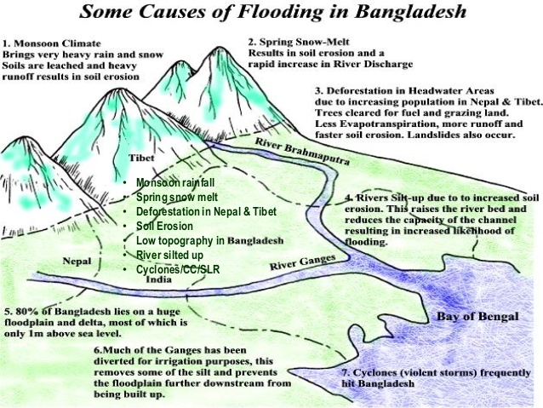

Slide 51
Droughts:
Bangladesh experiences Drought conditions at some intervals of time. In 1979 Bangladesh passed through a major drought year which was trend by many as the worst in the recent past.

Slide 52
Major Natural Hazards/Disasters of Bangladesh
Earthquakes:
Bangladesh has potentiality for earthquake hazards as per the recorded history. According to GSHAP data, Bangladesh lies in a region with low to high seismic hazard that increases in the northern and eastern parts of the country. Historically, earthquakes in the M6.0-7.0 range have been experienced in Chittagong, Dhaka and Sylhet divisions while events in the M5.0-6.0 range have been experienced in Khulna and Rajshahi divisions.

Slide 53
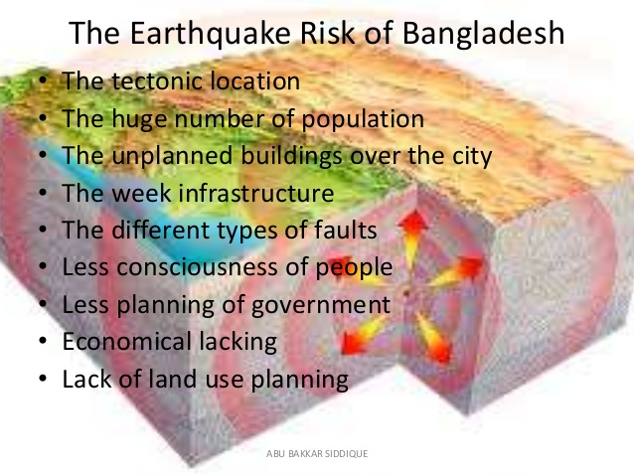

Slide 54
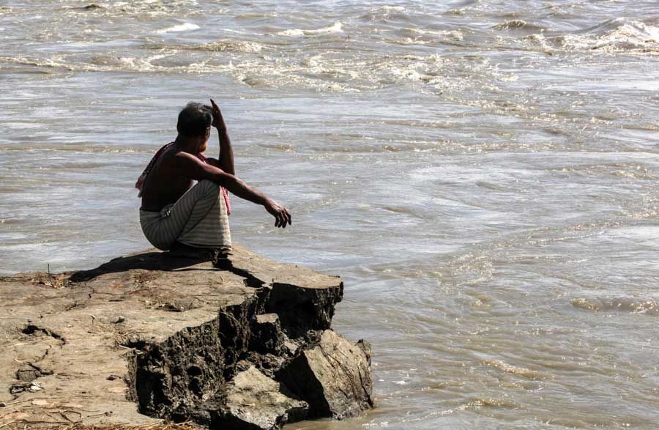
River bank erosions:
Riverbank erosion, one of the major natural disasters in Bangladesh, causes untold miseries every year to thousands of people living along the banks of the rivers. Along the courses of the mighty rivers, like Jamuna, Meghna, etc. erosion every year takes away chunks of land causing displacement of large number of people and losses of properties.
Bangladesh is projected to lose around 2,270 hectares of land this year due to riverbank erosion, a study report has said.

Slide 55
Tornadoes:
Bangladesh has been facing the severe tornado incidents from the historical ages due to its geographical location. In recent years, it becomes more frequent; even hit the land more than six times in a year. Tornadoes cause localized devastation and demand an immediate response. A severe tornado hit Tangail district of the country on 13th May 1996 causing 540 death and injuring about 34000 people. Loss of cattle heads and damages to homes were also substantial.
Arsenic contamination:
The contamination of groundwater by arsenic in Bangladesh is one of the largest poisoning of a population in the history. The scale of this environmental poisoning disaster is greater than any seen before.

Slide 56
Impacts of Disasters
•Climate Change Impacts
•Agriculture
•Salinity Intrusion
•Forests
•Fisheries
•Ecosystem and Biodiversity
Emergency relief from abroad:
The major help came from Japan, USAID, India, Canada, Saudi Arabia, UAE, European Union, World Bank, ADB, 1DB, ODA etc.

Slide 57
How environment influence people
The temperate climate of Bengal also make people mild and amicable.it endowed them with finer sentiments which sweetened their home life as well as social life.
The food, dress, transport and various other aspects of life were conditioned by the nature. The plains of Bengal produced rice abundantly and its rivers supplied plenty of fishes. Hence these are the main foods of this region.
The climate of the country acted like the third line of defense against the outside attack.

Slide 58
How environment influence people
The geographical peculiarities, such as natural barriers on the borders, the innumerable rivers and waterways through the plains, the marshes, rains and climate conditioned the life and culture of its people through the ages.
The geography and nature subsequently helped Bengal/Bangladesh in maintaining an independent political career for several centuries. It maintained an independent existence throughout the Hindu period, with the exception of a few years under Asoka and about a century in the reigns of the imperial guptas. In muslim period Bengal remained practically independent ever since its conquest by Ikhtiar-Uddin Muhammad bin bakhtiar khalji in 1204-1205ad.

Slide 59
Mineral resources are very valuable from all the natural resources. It is very important for any country’s economic development. Bangladesh is not rich in mineral resources. Coal, iron, mineral oil is the main resource for the development of a country. Those countries are developed which are utilizing their mineral resources properly. As example we can tell about United States of America, United Arab Emirates, Saudi Arabia, Russian Federation, Kuwait etc. Nowadays we are looking that it is going for become industrialized. So, mineral resources are not only important for our country but also too much essential. Now these resources are heavily used in our industrial sector as raw material.

Slide 60
Classification of mineral resources of Bangladesh
Those are listed below-
Power resources:
Immaterial mineral resources.
Material mineral resources.
Power resources: All the mineral resources which are used to produce power for our uses are called power resources. Some of our mineral resources are in this category. Those are
Natural Gas.
Coal.
Carosine Oil.
Petroleum etc
Though we have some other power resources which are not coming from mineral those areas-
Wood fuel.
Electric power.
Tidal power etc.

Slide 61

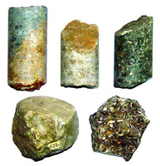
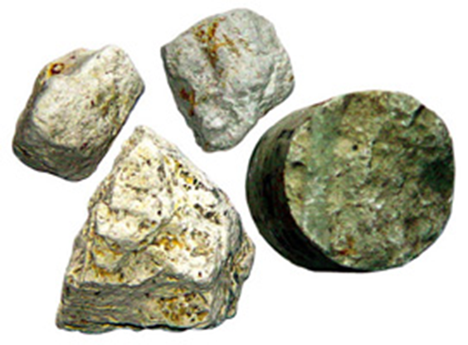
Immaterial mineral resources: All mineral resources which are not material can be categorized in this group. We can have some of this resource. That are-
Lime stone
Glass sand (silica sand)
China clay (White clay)
Hard Rock
Mineral Sand
Salt
Atomic Sand
Sulfur
Glass sand, Comilla
Fossiliferous limestone, Sylhet
White clay, Netrokona

Slide 62
Material mineral resources:
Copper
Iron
Zinc etc.
Though these types of resources are not found in our country but many scientist thinks that we might have these resources under the surface and we may discovered its future period and consume it.

Slide 63
Description of mineral and power resources of Bangladesh
Natural Gas: Natural Gas is the most important resources for our country. From the very past time our scientist assume that our country have a huge amount of natural gas, but we discovered these gas fields for the first time just after 1950.
Coal: Coal is an important mineral resource for Bangladesh. We have different types of coal. That are-
Bituminous coal (best coal in Bangladesh)
Pit coal
Lignite coal (worst coal in Bangladesh)
Mineral oil:
In 1987 our scientists found an oil field in Sylhet’s Horipur and another one in Bormihal of Moulovibazar. In Haripur we have four core barrel oil reserves.
Limestone: Limestone is popular for the raw materials of cement. Limestones have been discovered in Nineteen Century at Sylhet’s Jaflong and Joyontika.

Slide 64
Silica Sand: Silica sand is the main raw material of glass industry. For these reason it is also called as glass sand. Silica sand is available in many places of Bangladesh.
White clay: Mainly it is used to produce Ceramic products and sanitary products. China clay is important for our ceramic and sanitary industry. Now a days it is also used as row material of electric accessories producing industry and some chemical industry.
Mineral Sand:
An Australian scientist had discovered the mineral sand in the sea shore of Cox’sBazar for the first time. This discovery might be a great opportunity for Bangladesh. This mineral sand is also called as radioactive sand. Scientist found this type of sand in follows place-
Cox’esbazar
Takenaf
Moheskhali
Maturberi
Kutubdia

Slide 65
Salt: Though salt is one kind of mineral resource but for our country it could not be called mineral resource. Main source of salt in our country is sea water that’s why it could not be called mineral resource in our country.
Sulfur: Now we found little quantity of sulfur in our country. In Bangladesh we found it in Kutubdia which is in Cox’s Bazar District.
Wood fuel: It is one kind of power resource in our country. Still today many people of our country use wood fuel for their daily purpose like cooking. Using wood fuel as the source energy is little bit harmful for our nature.
Electric power: Electric power is very important for our country. Most of our industries are being operated by electricity. Bangladesh has total ten centers where electricity has been producing.
Tidal power: Our government should have to take proper care and give proper attention in this sector by using tidal power so that we can produce more electricity.

Slide 66
Uses of mineral resources: Industrial setup
Some uses of our mineral resources for the development of our economy in industrial sector are given bellow-
Raw material and industrial development in Bangladesh: We are using Natural Gas, Silica Sand, white clay as raw material. For these reason Fertilizer, Cement industry are developing in our country. So we can tell mineral resources helping us to make our country industrialized.
Power source: Maximum small and large industries are using heat Electricity and natural gas is main element or key element to produced heat electricity.
Fuel: Natural gas founded in Bangladesh used as fuel for cooking. For this reason most Bangladeshi people gets most economic facilities. On other hand gas also used for produce heat in most fertilized factory.
Natural Gas: Our natural gas and other resources helping us, it makes our import cost of gas and other energy very low. All the mineral resources that we have we need not to import those. By this way they saved a huge amount of foreign currency.

Slide 67
Development of Agriculture: Our mineral resources especially natural gases help us to produce more agricultural product indirectly. Natural gas helps to produce fertilizer and fertilizer helps us to produce more crops.
National income: Mineral resources of a country help to increase the national income of the country.
Higher living standard: Availability of mineral resources makes our national income higher. It helps to create employment opportunities and spread economic activities. As a result per capital income also rises and standard of living of our people being higher People are getting more facilities. For development of our industrial sector and our economy it has great importance. But we are very unlucky that we have lack of sufficient amount of mineral resources. Iron, Manganese, Bauxite etc . mineral is not available in our country and our oil resources are not rich enough. If we have these resources then our country could be more developed.

Slide 68
Solve Unemployment: Mineral and power resources help to spread our economic activities and solve little portion of unemployment problem, It helps us to solve unemployment thus this way—–
Many people all over the country works in different places. People work in gas field Oil field and other places when we find our mineral resource. It creates opportunity for our people to get works and get new job.
For mineral resources many industry are building our country, it also creating many people’s employment opportunity.

Slide 69
Pre-History
Stone Age remnants have been found in Bengal that date back 20,000 years. Regions which have yielded prehistoric artifacts in Bangladesh are the Lalmai hills near Comilla, Chaklapunji Tea Garden of Chunarughat in the Habiganj district of Sylhet, Sitakunda and Rangamati of the Chittagong region, and the Wari-Bateshwar of Narshingdi district. These regions of Bangladesh contain both Pleistocene deposits and suitable raw materials. Wari-Bateshwar, several Neolithic tools such as celts, shouldered axes, etc made on sand stone, silt stone and fossil wood have been found, though their raw materials are not locally available. The most suitable rock in this region is fossil wood and this is what was used as the raw material of the prehistoric industry of Bengal region.

Slide 70
Ancient Bengal Janapadas
Bengal was split up into several independent kingdoms, completely unifying only several times. In ancient times, Bengal consisted of the kingdoms of Vanga, Pundra, Suhma, Anga, Samatata and Harikela.
The Vanga: The Vanga is an ancient human settlement situated in Eastern Bengal. But its geographical connotation varied in different periods of history. The Hindu literatures indicate that the Vanga is sea-faring nation and its realm extended up to the sea. They also mentioned that this is an area where finest quality white & soft cotton fabrics were produced. There was a coastal area approachable from the sea in the territory of Vanga. From the above mentioned references, Vanga appears to be an area of south and southeastern part of present Bangladesh.

Slide 71
Janapadas
The Pundra The Pundra or Pundranagara is the earliest urban centre in Bangladesh, which goes back to the 4th century BC. The ruins of this have been identified at Mahasthan in Bogra district. It continued to be the headquarters of the administration of Maurya, Gupta and Pals. It was the capital of Pundrabardhan Bhukti under the Gupta rule. Pundra was situated on the western bank of the Karatoya. It was well connected with other parts of Bengal through land and river routes. For this connection it was an important centre of trade and commerce throughout the ancient period. Pundra continued its importance after the Hindu regime and in the early Muslim period. The famous Muslim saint Shah Sultan Balkhi Mahisawar established his Khankah here.

Slide 72
Janapadas
The Gauda As an ancient human settlement, Gauda is the important Janapad of Bengal. The discovered evidence suggests that ancient Gauda located at coastal region. The famous & the first independent ruler of Gauda is Shashanka. He ruled Gauda at the 7th century AD and his capital was the Karnasuborna which is located at present Murshidabad district. The Janapad of Gauda lay to the west of Bhagirathi and that its core area was Murshidabad. In the 13th century, under the Sultans, Gauda denoted the entire area of the Muslim sultanate. Its capital also called Gaur or Lakhnaboti, located at present Chapai Nawabgonj district.

Slide 73
Janapadas
The Radha (ra-ro) Radha is the ancient human settlement of Bengal. It is difficult to locate exactly its geographical position. But historical sources suggest that Radha is the west-southern part of ancient Bengal. Howrah, Hughli and Burdwan in West Bengal are some areas of ancient Radha. The Somotata Samatata is an ancient territorial unit in ancient Bengal. Chinese traveler Hiuen-tsang visited Samatata at 7th century AD. As per his account, it was the South-eastern part of Bengal and was a Buddhist cultural centre. The archaeological discoveries in the Lalmai-Mainamati area, it can now be stated with certainty that Samatata was formed at Comilla-Noakhali areas and the adjacent parts of hilly Tripura.

Slide 74
Janapadas
The Harikel Harikel is another geographical entity in ancient Bengal. But it is so difficult to locate it. Most of the evidence support that Harikel is the similar with our present Sylhet region. Another archeological evidence suggests its location at present Chittagong district. Harikel was situated by the side of Samatata.

Slide 75
Ancient Bengal
Bengal is a 4,000 year old civilization that thrived between the banks of Ganges to Brahmaputra and sustained itself with the riches of Gangetic Delta.
Remnants of earliest cities in the state date back to the Vedic Period. The oldest archaeological sites in Bangladesh are Mahasthangarh and Wari-Bateshwar, which dates back to 700 B.C. and 600 B.C. The culture and ethnicity of Bengal was different than that of the Vedic people.

Slide 76
Ancient Dynasties of Bengal
Maurya Dynasty (324 BC - 185 BC)
Chandragupta Maurya unified all Indian provinces, except the North-East, Tamil and Kalinga. His empire spanned from Bengal to Baluchistan. During his reign, Bengal flourished with riches and its naval fleet got stronger.
Gauda Empire (590 CE - 626 CE)
After the Mauryan Empire, other kingdoms and dynasties such as the Gupta, Kanvas, Shungas ascended to the throne of Bengal. But it was during the rule of King Shashanka that Bengal witnessed another flourishing period. Shashanka was a strong ruler who developed Bengal's architecture and calendar. He is infamous for oppressing Buddhist communities and driving them out of Bengal. Shashanka's capital, Karna Suvarna is now known as Murshidabad.

Slide 77
Ancient Dynasties of Bengal
Pala Empire (750 CE - 1200 CE)
Often dubbed as the 'Golden Age' of Bengal, the Pala Empire indeed raised the standards of Bengal's culture and politics. Followers of Buddhist philosophy, the Pala kings promoted classical Indian philosophy, literature, painting and sculpture studies. It was during this period that the Bengali language was formed in its entirety. Epics and sagas were written such as the 'Mangal Kavyas'. The Palas were also known for their war elephant cavalry and strong naval fleet.

Slide 78
Ancient Dynasties of Bengal
Chandra Dynasty
The Chandra dynasty were a family who ruled over the kingdom of Harikela in eastern Bengal (comprising the ancient lands of Harikela, Vanga and Samatala) for roughly a century and a half from the beginning of the 10th century CE. Their empire also encompassed Vanga and Samatala, with Srichandra expanding his domain to include parts of Kamarupa. Their empire was ruled from their capital, Vikrampur (modern Munshiganj) and was powerful enough to militarily withstand the Pala Empire to the north-west. The last ruler of the Chandra Dynasty Govindachandra was defeated by the south Indian Emperor Rajendra Chola I of the Chola dynasty in the 11th century. Then it was under rule of Keshari dynasty of Utkal and subsequently under Ganga Dynasty of Kalinga followed by Surya dynasty of Kalinga till 1568 .

Slide 79
Ancient Dynasties of Bengal
Sena Empire
The Pala dynasty was followed by the Sena dynasty, who brought Bengal under one ruler during the 12th century. Vijaya Sena, second ruler of the dynasty, defeated the last Pala emperor, Madanapala, and established his reign.
Ballala Sena introduced caste into Bengal and made Nabadwip his capital.
The fourth Sena king, Lakshmana Sena, expanded the empire beyond Bengal to Bihar, Assam, Odisha and likely Varanasi. Lakshmana was later defeated by the Muslims and fled to eastern Bengal, where he ruled few more years. The Sena dynasty brought a revival of Hinduism and cultivated Sanskrit literature in India. It is proposed by some Bengali authors that Jayadeva, the famous Sanskrit poet and author of Gita Govinda, was one of the Pancharatnas or "five Gems" of the court of Lakshmana Sena.

Slide 80
Ancient Dynasties of Bengal
Deva Kingdom
The Deva Kingdom was a Hindu dynasty of medieval Bengal that ruled over eastern Bengal after the collapse Sena Empire. The capital of this dynasty was Bikrampur in present-day Munshiganj District of Bangladesh. The inscriptional evidences show that his kingdom was extended up to the present-day Comilla–Noakhali–Chittagong region. A later ruler of the dynasty Ariraja-Danuja-Madhava Dasharatha-Deva extended his kingdom to cover much of East Bengal.The end of this dynasty is not yet known.

Slide 81
Medieval/ Muslim Period
Islam made its first appearance in Bengal during the 12th century when Sufi missionaries arrived. Later, occasional Muslim conquerors reinforced the process of conversion by building mosques, madrassas and Sufi Khanqah. Beginning in 1202 a military commander from the Delhi Sultanate, Bakhtiar Khilji, overran Bihar and Bengal as far east as Rangpur, Bogra and the Brahmaputra River. Although he failed to bring Bengal under his control, the expedition managed to defeat Lakshman Sen and his two sons moved to a place then called Bikrampur (present-day Munshiganj District), where their diminished dominion lasted until the late 13th century.
During the 14th century, the former kingdom became known as the Sultanate of Bengal, ruled intermittently with the Sultanate of Delhi.

Slide 82
Medieval/ Muslim Period
Ilyas Shahi dynasty
Shamsuddin Iliyas Shah founded the dynasty. It lasted from 1342–1487. The dynasty successfully repulsed attempts by Delhi to conquer them. They continued to reel in the territory of modern-day Bengal, reaching to Khulna in the south and Sylhet in the east. The sultans advanced civic institutions and became more responsive and "native" in their outlook and cut loose from Delhi. Considerable architectural projects were completed including the massive Adina Mosque and the Darasbari Mosque which still stands in Bangladesh. The Sultans of Bengal were patrons of Bengali literature and began a process in which Bengali culture and identity would flourish. The Ilyas Shahi Dynasty was interrupted by an uprising by the Hindus under Raja Ganesha. However the Ilyas Shahi dynasty was restored by Nasiruddin Mahmud Shah.

Slide 83
Medieval/ Muslim Period
Ganesha dynasty
The Ganesha dynasty began with Raja Ganesha in 1414. After Raja Ganesha seized control over Bengal he faced an imminent threat of invasion. Ganesha appealed to a powerful Muslim holy man named Qutb al Alam, to stop the threat. The saint agreed on the condition that Raja Ganesha's son Jadu would convert to Islam and rule in his place. Raja Ganesha agreed and Jadu started ruling Bengal as Jalaluddin Muhammad Shah in 1415 CE. Qutb al Alam died in 1416 CE and Raja Ganesha was emboldened to depose his son and accede to the throne himself as Danujamarddana Deva. Jalaluddin was reconverted to Hinduism by the Golden Cow ritual. After the death of his father he once again converted to Islam and started ruling his second phase. Jalaluddin's son, Shamsuddin Ahmad Shah ruled for only 3 years due to chaos and anarchy

Slide 84
Medieval/ Muslim Period
Hussain Shahi dynasty
The Hussain Shahi dynasty ruled in the period 1494–1538. Alauddin Hussain Shah, considered as the greatest of all the sultans of Bengal for bringing cultural renaissance during his reign. He extended the sultanate all the way to the port of Chittagong, which witnessed the arrival of the first Portuguese merchants. Nasiruddin Nasrat Shah gave refuge to the Afghan lords during the invasion of Babur though he remained neutral. However Nusrat Shah made a treaty with Babur and saved Bengal from a Mughal invasion. The last Sultan of the dynasty, who continued to rule from Gaur, had to contend with rising Afghan activity on his northwestern border. Eventually, the Afghans broke through and sacked the capital in 1538 where they remained for several decades until the arrival of the Mughals

Slide 85
Medieval/ Muslim Period
Mughal period
In 1534, the Afghan Sher Shah Suri, or Farid Khan – a man of incredible military and political skill – succeeded in defeating the superior forces of the Mughals under Humayun at Chausa (1539) and Kannauj (1540). Sher Shah fought back and captured both Delhi and Agra and established a kingdom stretching far into Punjab. Sher Shah's administrative skill showed in his public works, including the Grand Trunk Road connecting Sonargaon in Bengal with Peshawar in the Hindu Kush. Sher Shah's rule ended with his death in 1545, although even in those five years his reign would have a powerful influence on Indian society, politics, and economics. Shah Suri's successors lacked his administrative skill, and quarrelled over the domains of his empire. Humayun, who then ruled a rump Mughal state, saw an opportunity and in 1554 seized Lahore and Delhi.

Slide 86
Medieval/ Muslim Period
Emperor Humayun died in January 1556. Around same time, Hemu, also called Hema Chandra Vikramaditya, the then Hindu Prime Minister-cum-Chief of Army, of the Sur dynasty won Bengal in the 'battle at Chapperghatta', killing Muhammad Shah the then ruler of Bengal. This was Hemu's 20th continuous win in North India. Knowing of Humanyun's death, Hemu found a God given opportunity to win Delhi for himself and rushed to Delhi to win Agra and later on Delhi, defeated Akbar's forces at both the places, and established 'Hindu Raj' in North India on 6 Oct 1556, after 300 years of Muslim rule, leaving Bengal to his Governor Shahbaz Khan.

Slide 87
Medieval/ Muslim Period
Akbar, the greatest of the Mughal emperors, defeated the Karani rulers of Bengal in 1576. Afterwards, Bengal came once more under the control of Delhi. It became a Mughalsubah and ruled through subahdars (governors). Akbar exercised progressive rule and oversaw a period of prosperity (through trade and development) in Bengal and northern India.

Slide 88
Emergence of the Nawabs of Bengal
Bengal's trade and wealth impressed the Mughals that they called the region the "Paradise of the Nations". Administration by governors appointed by the court of the Mughal Empire court (1575–1717) gave way to four decades of semi-independence under the Nawabs of Murshidabad, who respected the nominal sovereignty of the Mughals in Delhi. The Nawabs granted permission to the French East India Company to establish a trading post at Chandernagore in 1673, and the British East India Company at Calcutta in 1690.

Slide 89
Murshid Quli Khan arrived as the Diwan of Bengal in 1717 AD. Before his arrival, there were four Diwans. Murshid Khan was appointed the "Nawab Nizam of Bengal" and he emerged as the ruler of Bengal under the Mughals.Murshidabad remained the capital of the Nawabs of Bengal until their rule.The Nawab Siraj ud-Daulah, was betrayed in the Battle of Plassey by Mir Jaffer. He lost to the British East India Company, who took installed Mir Jaffer on the Masnad (throne), as a "puppet ruler" and established itself to a political power in Bengal.

Slide 90
Sultans
1. Ilyas Shahi dynasty (1342-1414)
2. House of Raja Ganesha (1414-1435)
3. Restored Ilyas Shahi dynasty (1435-1487)
4. Habshi rule (1487-1494)
5. Hussain Shahi dynasty (1494-1538)
6. Governors under Suri rule (1539-1554)
7. Muhammad Shah dynasty (1554-1564)
8. Karrani dynasty (1564-1576)

Slide 91
Economy
Economy
The Indian economy was large and prosperous under the Mughal Empire. During the Mughal era, the gross domestic product (GDP) of India in 1600 was estimated at about 22.4% of the world economy, the second largest in the world, behind only Ming China but larger than Europe. By 1700, the GDP of Mughal India had risen to 24.4% of the world economy, the largest in the world, larger than both Qing China and Western Europe. Mughal India was the world leader in manufacturing, producing about 25% of the world's industrial output up until the 18th century. India's GDP growth increased under the Mughal Empire. The Mughals were responsible for building an extensive road system. The empire had an extensive road network, which was vital to the economic infrastructure, built by a public works department set up by the Mughals which designed, constructed and maintained roads linking towns and cities across the empire, making trade easier to conduct.

Slide 92
Economy
Agriculture
Indian agricultural production increased under the Mughal Empire. A variety of crops were grown, including food crops such as wheat, rice, and barley, and non-food cash crops such as cotton, indigo and opium. By the mid-17th century, Indian cultivators begun to extensively grow two new crops like maize and tobacco. In early modern Europe, there was significant demand for products from Mughal India, particularly cotton textiles, as well as goods such as spices, peppers, indigo and silks.

Slide 93
Economy
Textile industry
The largest manufacturing industry in the Mughal Empire was textile manufacturing, particularly cotton textile manufacturing, which included the production of piece goods, calicos, and muslins, available unbleached and in a variety of colours. The cotton textile industry was responsible for a large part of the empire's international trade. India had a 25% share of the global textile trade in the early 18th century. Indian cotton textiles were the most important manufactured goods in world trade in the 18th century, consumed across the world from the America to Japan. By the early 18th century, Mughal Indian textiles were clothing people across the Indian subcontinent, Southeast Asia, Europe, the Americas, Africa, and the Middle East. The most important center of cotton production was the Bengal province, particularly around its capital city of Dhaka.

Slide 94
Economy
Bengal accounted for more than 50% of textiles and around 80% of silks imported by the Dutch from Asia, Bengali silk and cotton textiles were exported in large quantities to Europe, Indonesia, and Japan, and Bengali muslin textiles from Dhaka were sold in Central Asia, where they were known as "daka" textiles. Indian textiles dominated the Indian Ocean trade for centuries, were sold in the Atlantic Ocean trade, and had a 38% share of the West African trade in the early 18th century, while Indian calicos were major force in Europe, and Indian textiles accounted for 20% of total English trade with Southern Europe in the early 18th century.

Slide 95
Economy
Shipbuilding industry
Mughal India had a large shipbuilding industry, which was also largely centered in the Bengal province. In terms of shipbuilding tonnage during the 16th–18th centuries, the annual output of Bengal alone totaled around 2,232,500 tons, larger than the combined output of the Dutch (450,000–550,000 tons), the British (340,000 tons), and North America (23,061 tons).
Indian shipbuilding, particularly in Bengal, was advanced compared to European shipbuilding at the time, with Indians selling ships to European firms. Ship-repairing, for example, was very advanced in Bengal, where European shippers visited to repair vessels
The Mughals maintained a small fleet for carrying pilgrims to Mecca.

Slide 96
Other Aspects of culture
Urbanization
Cities and towns boomed under the Mughal Empire, which had a relatively high degree of urbanization for its time, with 15% of its population living in urban centers. This was higher than the percentage of the urban population in contemporary Europe at the time and higher than that of British India in the 19th century; the level of urbanization in Europe did not reach 15% until the 19th century.
Art and architecture
The Mughals made a major contribution to the Indian subcontinent with development of their unique architecture. Many monuments were built during the Mughal era by the Muslim emperors, especially Shah Jahan, including the Taj Mahal, a UNESCO World Heritage Site known to be one of the finer examples of Mughal architecture. Other World Heritage Sites include Humayun's Tomb, Fatehpur Sikri, the Red Fort, the Agra Fort, and the Lahore Fort.

Slide 97
Other Aspects of culture
Painting
Mughal paintings are a particular style of South Asian painting, generally confined to miniatures either as book illustrations or as single works to be kept in albums, which emerged from Persian miniature painting, with Indian Hindu, Jain, and Buddhist influences, and developed largely in the court of the Mughal Empire of the 16th to 18th centuries.

Slide 98


Slide 99
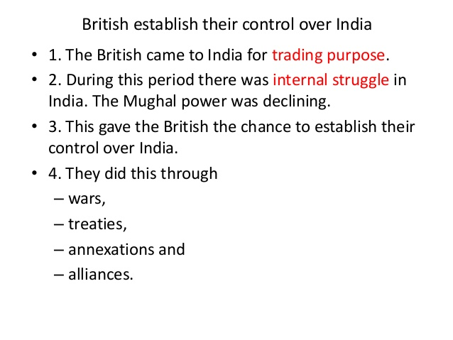

Slide 100
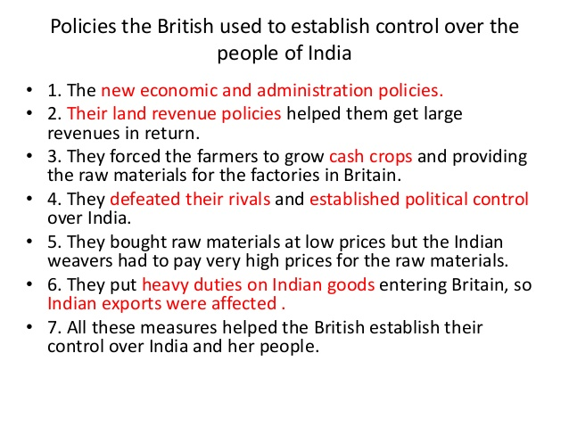

Slide 101
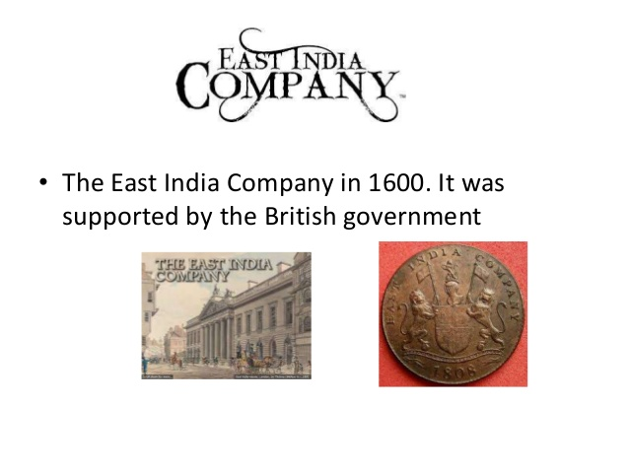

Slide 102
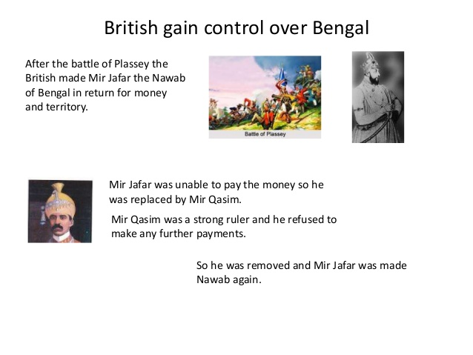

Slide 103
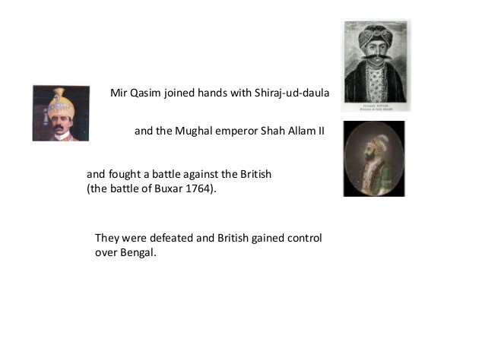

Slide 104
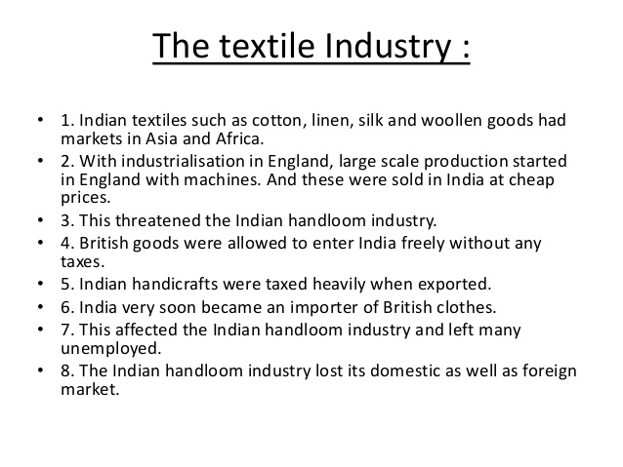

Slide 105
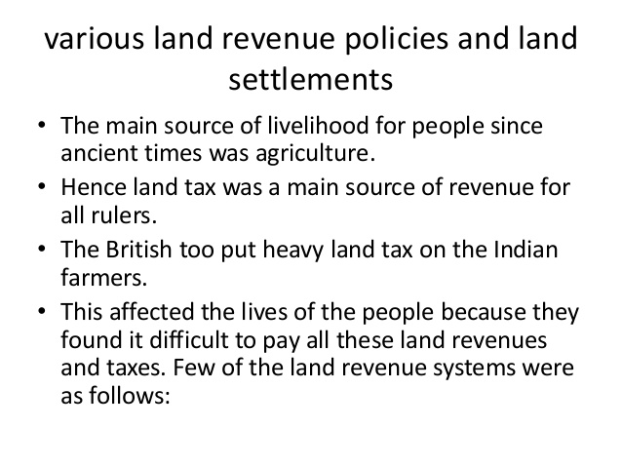

Slide 106
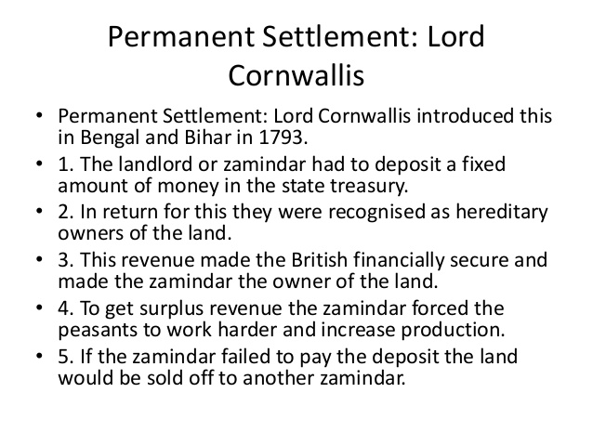

Slide 107
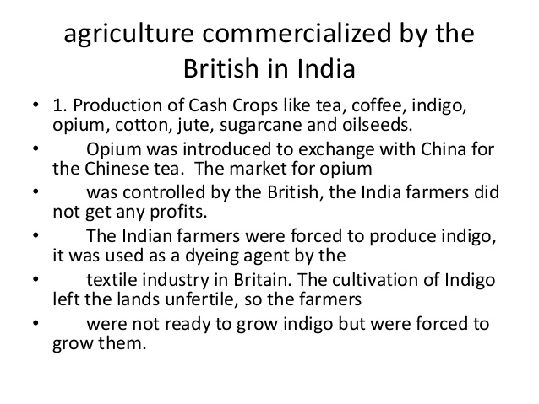

Slide 108
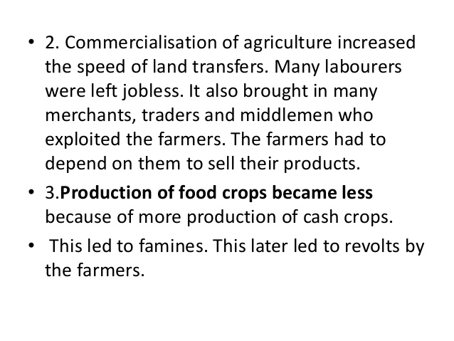

Slide 109


Slide 110
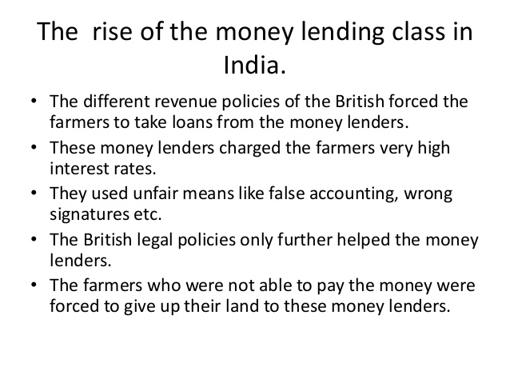

Slide 111
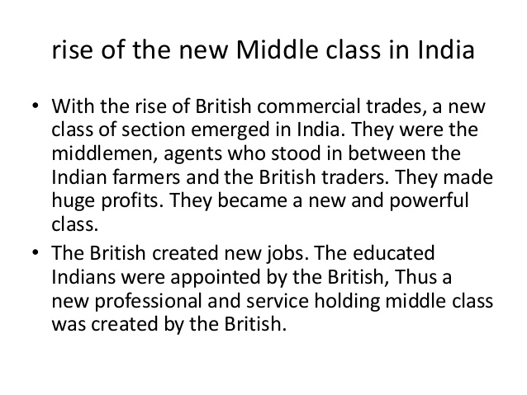

Slide 112
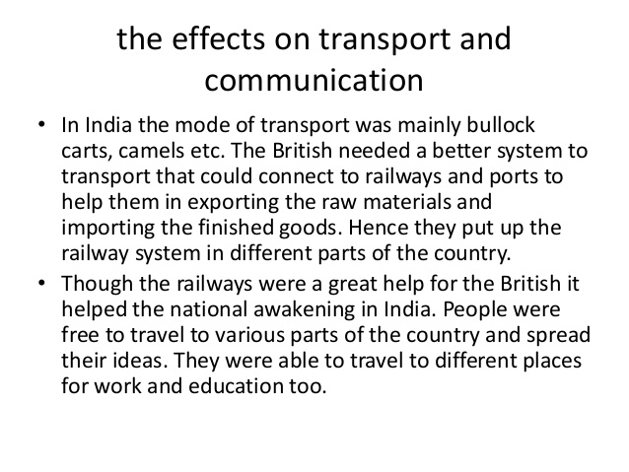

Slide 113
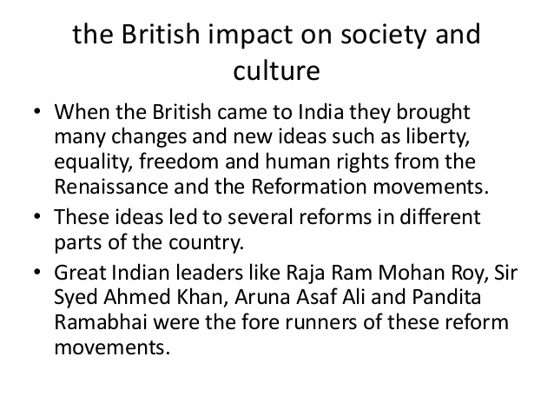

Slide 114
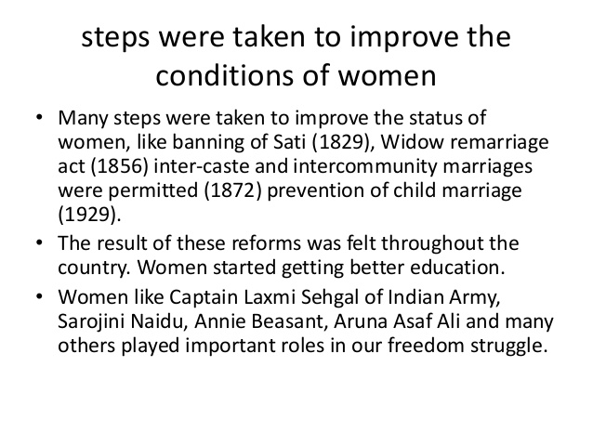

Slide 115
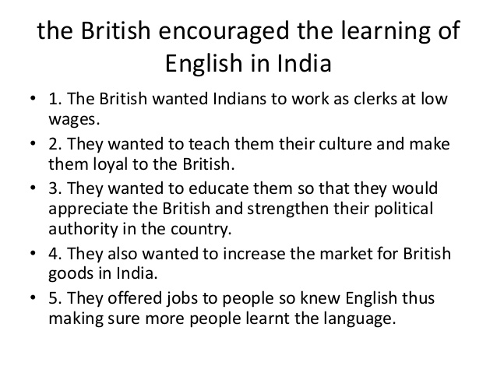

Slide 116
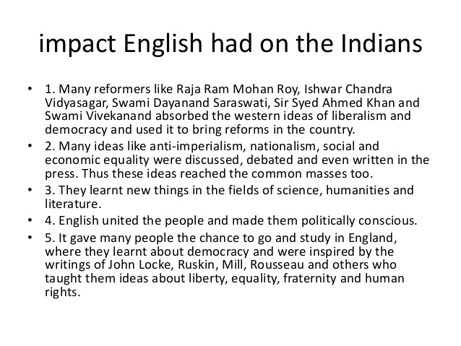

Slide 117
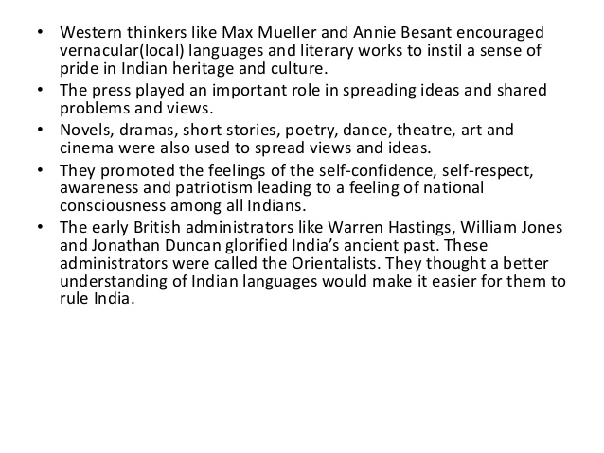

Slide 118
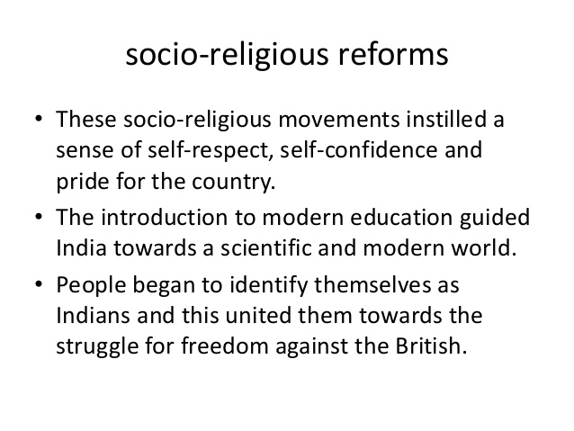

Slide 119
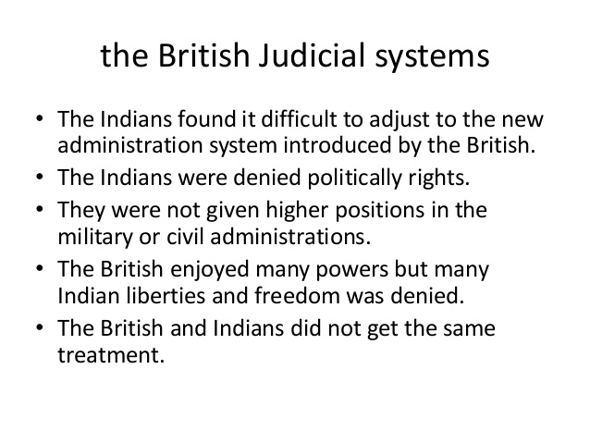

Slide 120
Introduction of Democracy
Britain introduced a lot of good things to India- democracy, for one thing. Before British rule, India was governed by the Mughal Emperors, who were effectively dictators. The British introduced a system of multi-party democracy for India's various state councils and regional legislatures, whereby the people's representatives were elected by popular vote.
In short, Britain brought India into the modern world of the 19th / 20th Centuries, raising it from the Mediaeval trough of feudal domination it had been languishing in beforehand, and creating a new, humane and advanced system of running a nation. The British also abolished some of the barbaric practices that were rife beforehand, such as that of burning a man's wife to death when he himself died.

Slide 121
Creation of Two States:
After world war II British were pressured to reduce the size of their empire.
Lord Mountbatten agreed for the partition of British India.
Britain declared two states Pakistan & India.
Pakistan was separated by East and West, and they were separated by thousands of miles of Indian territory.
The East and West were also very different in the way of their culture and the West area dominated the political ways of the country.

Slide 122
Pakistan State
Pakistan had two states: West Pakistan & East Pakistan.
Pakistan was separated by thousands of miles of Indian territory.
Urdu was spoken in the west and Bengali was spoken in the east.

Slide 123
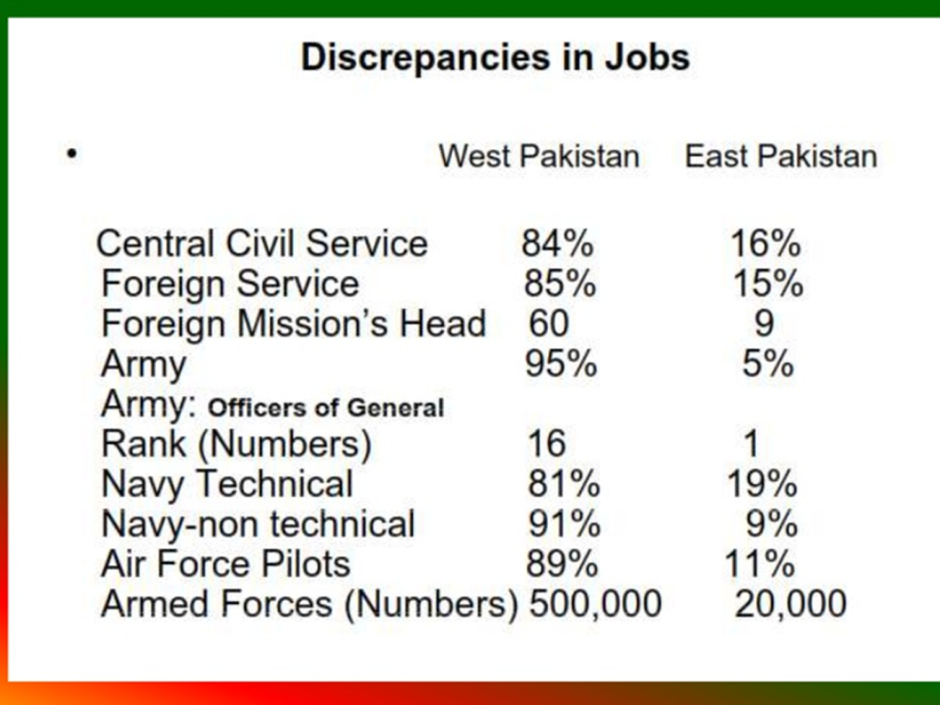
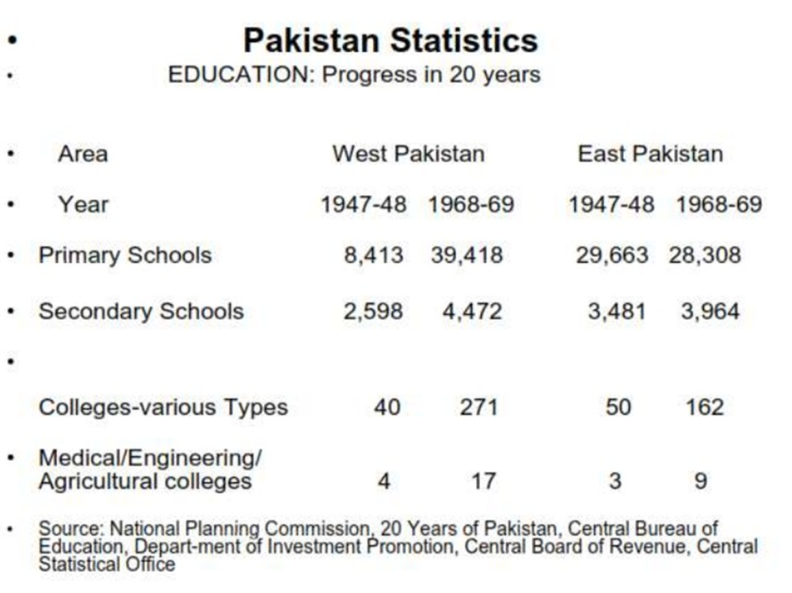
Background of Independence
The East and West were also very different in the way of their culture and society.
The West area dominated the political ways of the country.
Many discriminations were reportedly existing between East and West Pakistan on the societal, cultural, economical and political level.
Bangladesh had very poor representation in civil services and Arm forces as well as in commerce and industries.
Disparity in allotment of budget and development of state.
These discriminations lead to the independence of Bengal.

Slide 124
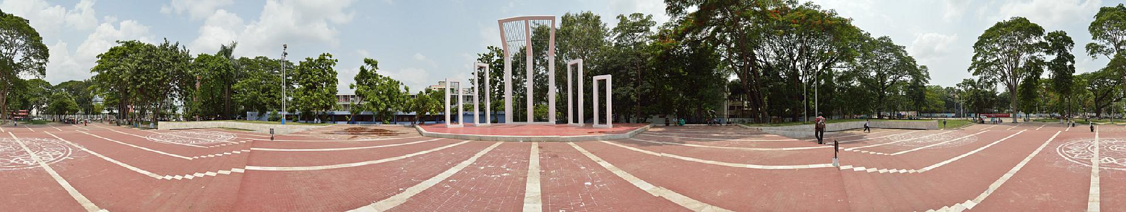
Language Movement (1952)
The conflict started when the subsequent state authorities declared that Urdu should be state language of the whole Pakistan.
Urdu was a language spoken by only 6% of people while ignoring the language of 54.6% people.
The protest culminated in students-police conflicts in the streets of Dhaka in 21 February 1952 leaving huge blood-shed.
Finally after years of conflict the central government granted Bengali as official state language of Pakistan.
21 February is now celebrated as the International Language day since 2000.

Slide 125
Importance of Language Movement
The Language Movement is one of the most important days in our history.
It has been suggested that the freedom struggle of Bangladesh originated from the Bengali language movement. In a way this is correct, as the basic inspiration for the freedom struggle of the Bengali-speaking people of Pakistan came mainly from linguistic nationalism.
Language is the prime carrier of a culture. It is also the most powerful instrument of preserving and developing our tangible and intangible heritage. During the course of world history, many cultures and civilizations have been shattered, devastated and crushed because of the demolition of their languages.

Slide 126
Language is not only the principal representative of a culture of one nation but it also creates sense of patriotism and nationalism in people’s mind. Bengali and Bangla language is an appropriate example of that.
Bengali people created one of the greatest political and cultural histories in the 20th century. The events of 21 February 1952 proved that a nation which is strong and powerful politically cannot destroy a spirited civilized nation if they have a unifying language like Bangla.
The General Election of 1954 and the language Issue: In March 1954, The United Front pledged that if they won in election, the following steps would be taken:
Bengali will be made one of the state languages of Pakistan.
Arrangements will be made to impart education through the mother tongue only.

Slide 127
Six Points Movement:
In February 1966, in a Conference in Lahore for restoration of democracy, Sheikh Mujibur Rahman declared the historic six points demands calling for:
Pakistan should be a federation of states with parliamentary system of government;
Only defense and foreign affairs should remain with the federal government;
There should either be separate currencies for the two wings or one currency for the whole country with its inter-wing flow to he regulated by the reserve banks of the two wings;
Taxes to be levied only by the regional governments, but a specified portion will automatically go to the federal account;
Separate accounts to be maintained for foreign currencies earned by each region; and
A separate militia or a paramilitary force to be created for the eastern wing.

Slide 128
Mass Upsurge of 1969
It was in line with the six points movement and against the military dictatorship of Ayub Khan.
Another vanguard of the anti-Ayub Mass Movement was the 'All Party Students Committee of Action’
All these directed to the fall of Ayub’s regime.
It was during the mass movement of 1969 that Bengali nationalism reached its highest point.

Slide 129
Call for Independence
After several years of political unrest the first election of Pakistan was called in 1970.
Awami league won all the seats in East Pakistan.
During the negotiations, the West Pakistani refused to accept the 6-point program and also refused to let Awami League to form government.
On March 7, 1971 Sheikh Mujibur Rahman made his historic freedom speech which called for the revolution for liberation.

Slide 130
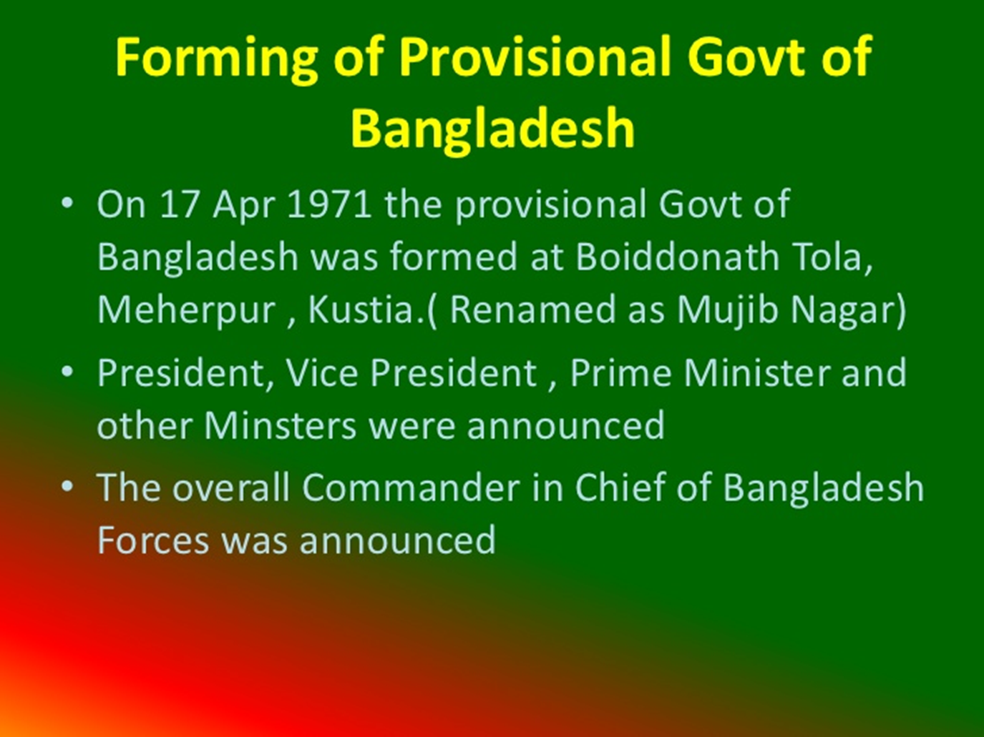

Slide 131
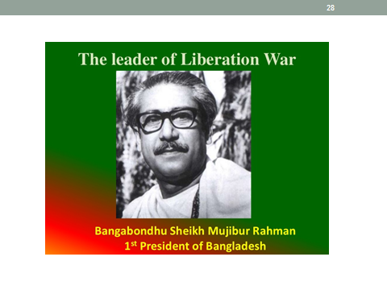

Slide 132
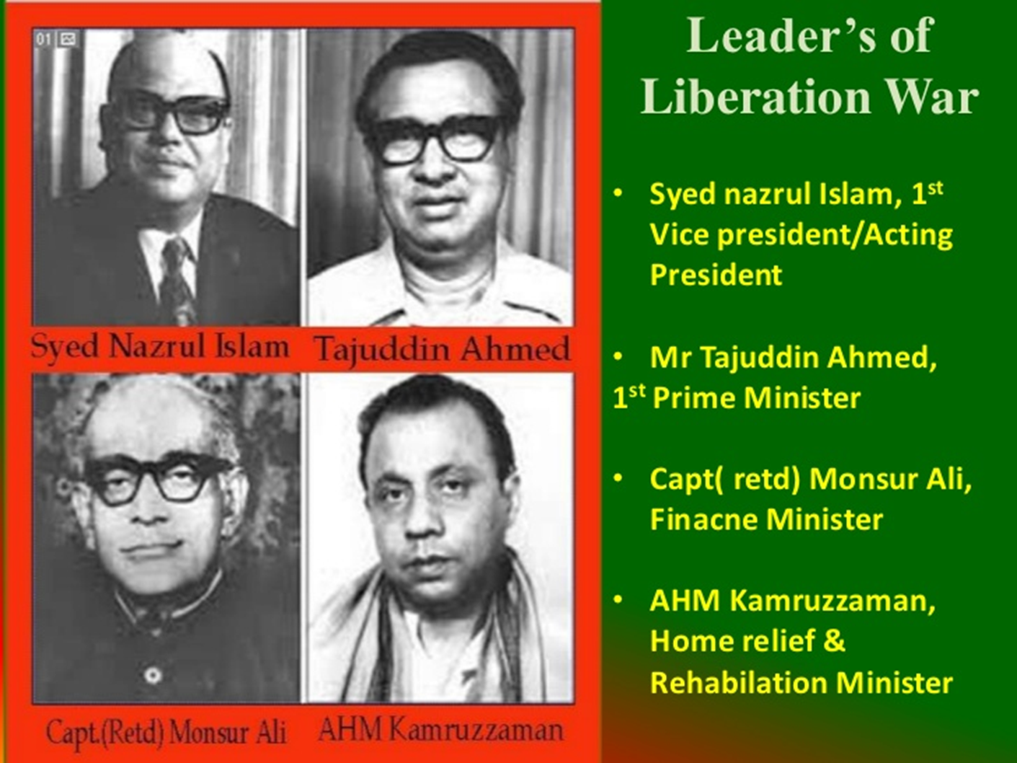

Slide 133
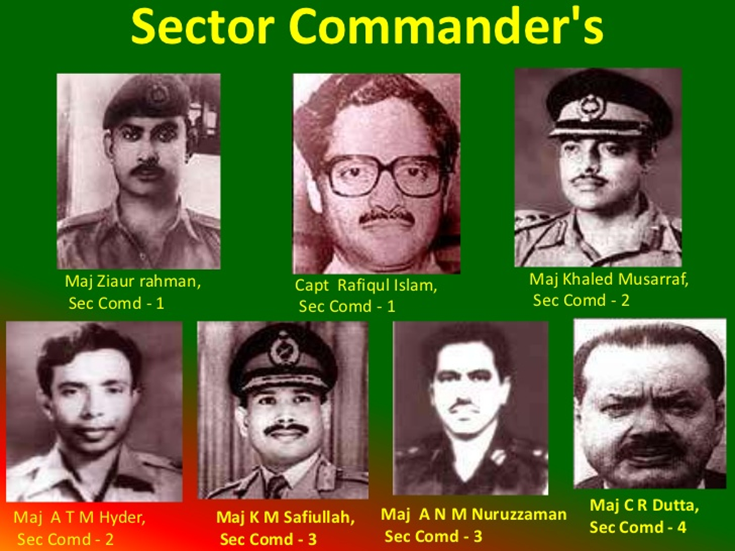

Slide 134
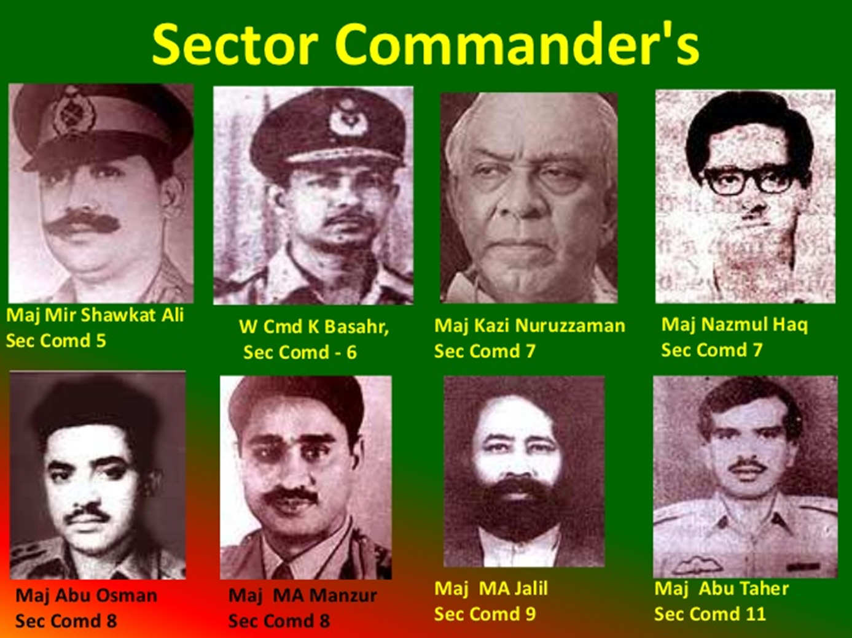

Slide 135
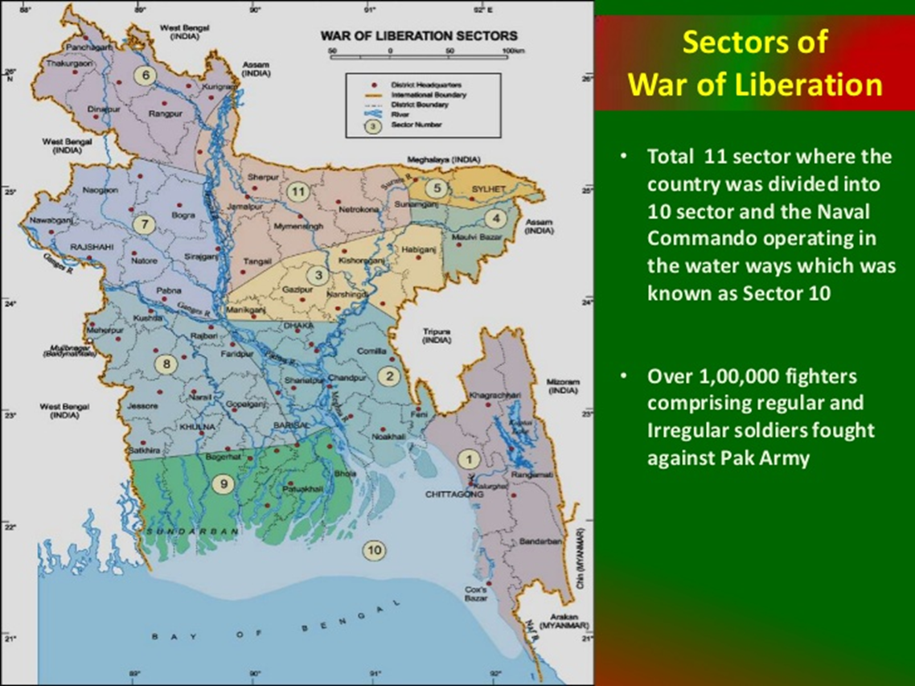

Slide 136
Basics Of The War
Lasted about 9 months – March 26, 1971 until December 16, 1971
India declared war on West Pakistan after the Pakistani Air Force (PAF) struck Indian airfields in northern India
The war ended 2 weeks later when India and the West had overpowered the East
Resulted in Bangladesh's independence from Pakistan

Slide 137
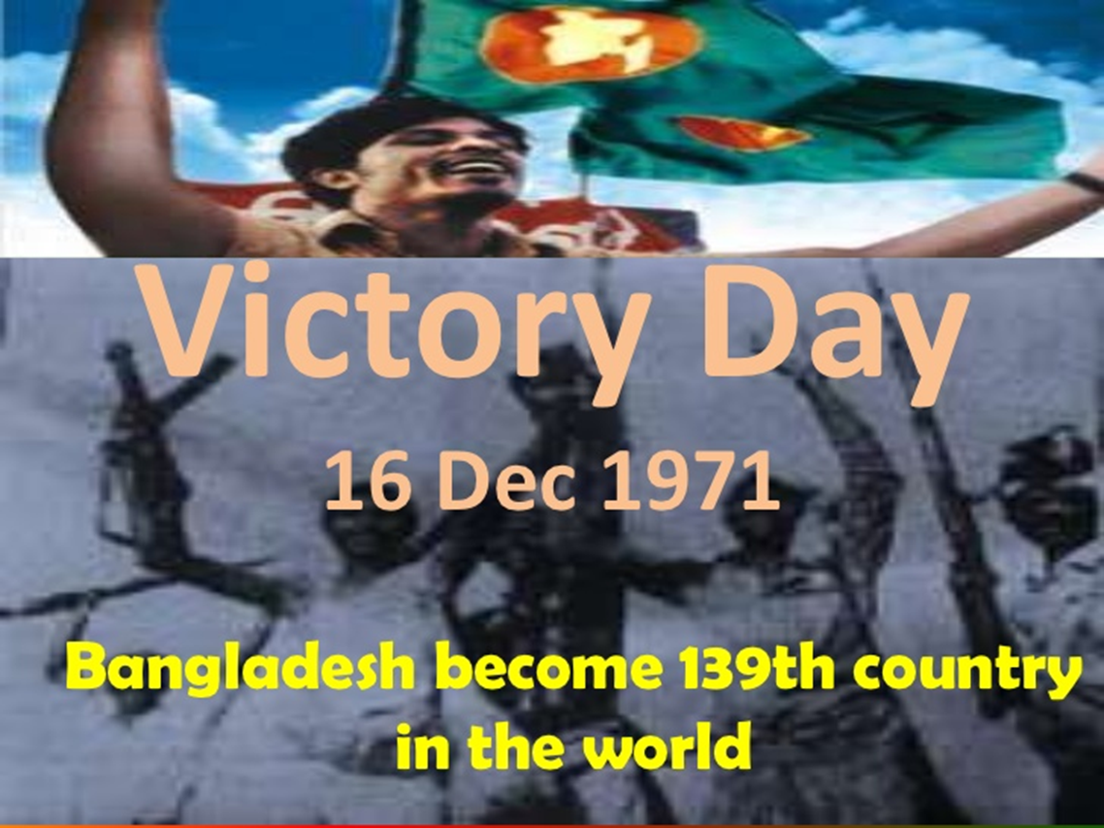

Slide 138


Slide 139
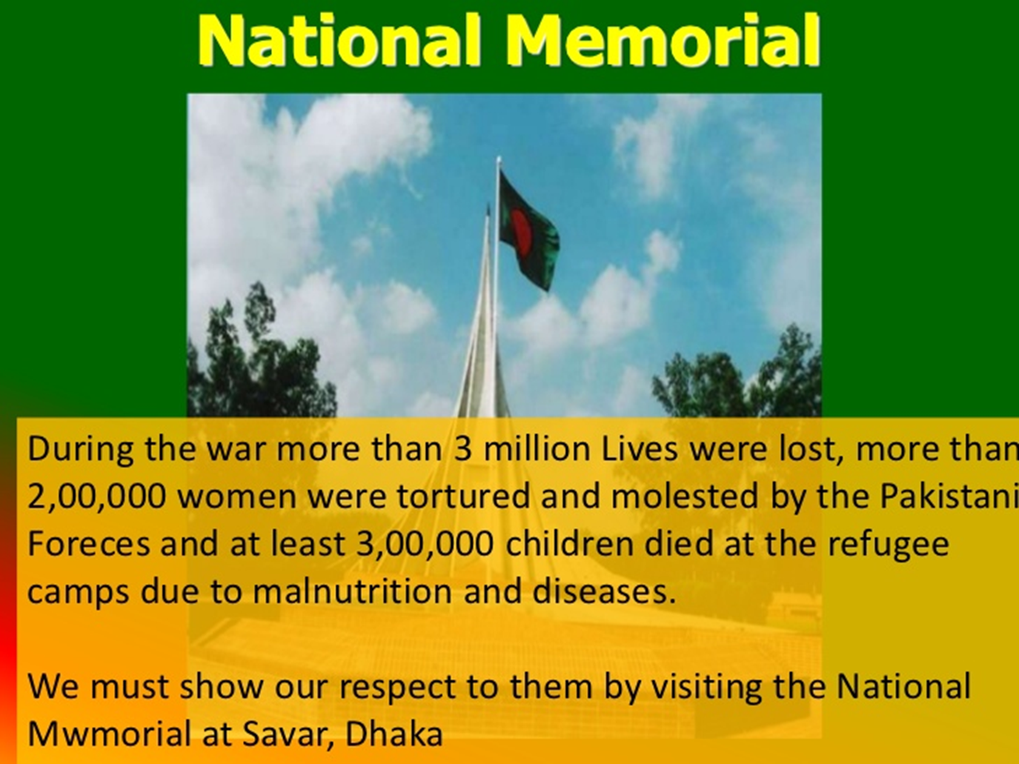

Slide 140


Slide 141
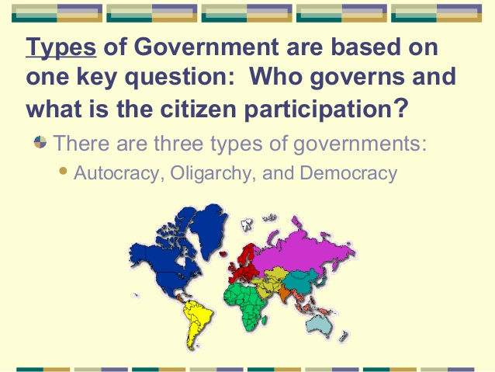

Slide 142
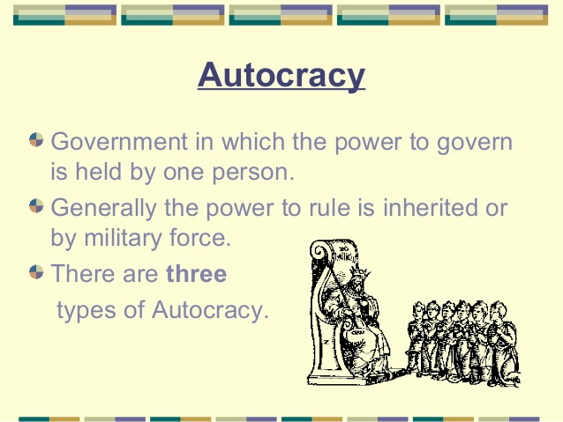

Slide 143


Slide 144
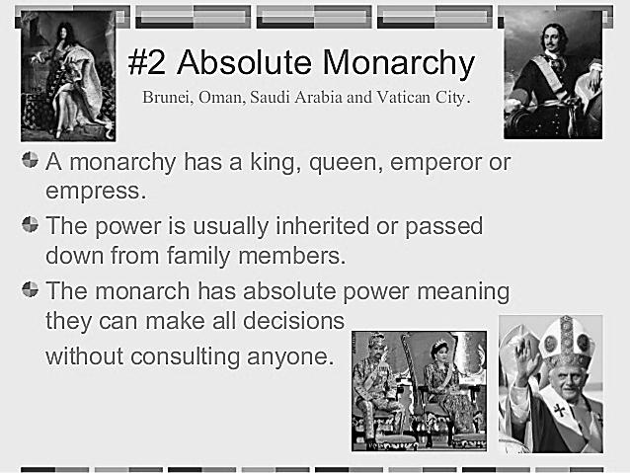

Slide 145


Slide 146


Slide 147


Slide 148


Slide 149
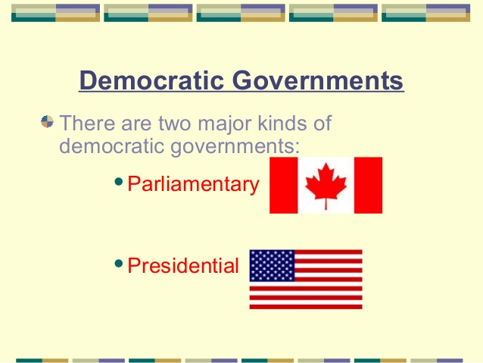

Slide 150
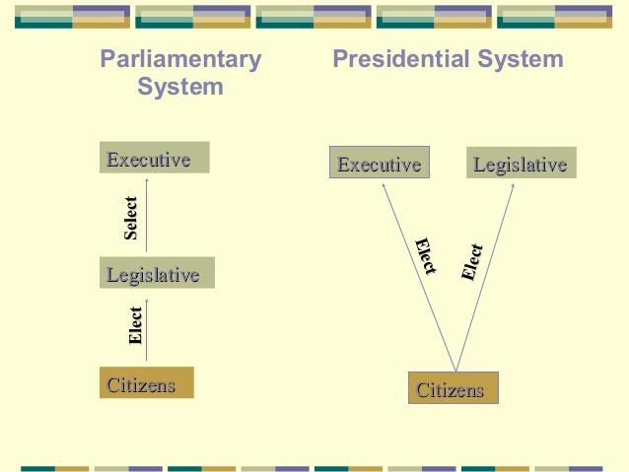

Slide 151
Republic
Rule by a form of government in which the people, or some significant portion of them, have supreme control over the government and where offices of state are elected or chosen by elected people.
Constitutional republic: Rule by a government whose powers are limited by law or a formal constitution, and chosen by a vote amongst at least some sections of the populace.
Examples: The United States, South Africa, India, etc.
Parliamentary republic: A republic, like India, Singapore and Poland, with an elected head of state, but where the head of state and head of government are kept separate with the head of government retaining most executive powers, or a head of state akin to a head of government, elected by a parliament.

Slide 152
Federal republic: A federal union of states or provinces with a republican form of government. Examples: Argentina, Austria, Brazil, Germany, India, Russia, and Switzerland
Islamic Republic: Republics governed in accordance with Islamic law. Examples: include Afghanistan, Pakistan, and Iran.
Socialist Republic: Countries like China and Vietnam are meant to be governed for and by the people, but with no direct elections. The term People's Republic is used to differentiate themselves from the earlier republic of their countries before the people's revolution, like the Republic of China and Republic of Korea.

Slide 153
Other types of govt system
Anarchy
Anarchy is a situation where there is no government. This can happen after a civil war in a country, when a government has been destroyed and rival groups are fighting to take its place.
Anarchists are people who believe that government is a bad thing in that it stops people organizing their own lives.
Example: Afghanistan
Capitalist
In a capitalist or free-market country, people can own their own businesses and property. People can also buy services for private use, such as- healthcare.
But most capitalist governments also provide their own education, health and welfare services.
Communist
In a communist country, the government owns property such as businesses and farms.
It provides its people's healthcare, education and welfare.

Slide 154
Government of Bangladesh
The Government of Bangladesh (Bengali: বাংলাদেশ সরকার Bangladesh Sôrkar GOB) is led by the Prime Minister, who selects all the remaining Ministers. The Prime Minister and the other most senior Ministers belong to the supreme decision-making committee, known as the Cabinet. The Government has three branches; the Executive branch, the Legislative branch and the Judicial branch.

Slide 155
Government system of Bangladesh
The Constitution of the People’s Republic of Bangladesh is the constitutional document of Bangladesh. It was adopted on 16 December 1972. It provides the framework of the Bangladeshi republic with a parliamentary government, fundamental human rights and freedoms, an independent judiciary, democratic local government and a national bureaucracy. The constitution includes references to socialism, Islam, secular democracy and the Bengali language. It commits Bangladesh to “contribute to international peace and co-operation in keeping with the progressive aspirations of mankind”.

Slide 156
Main office holders
Office | Name | Party | Since
President of Bangladesh | Abdul Hamid | Awami League | 24 March 2013
Prime Minister of Bangladesh | Sheikh Hasina Wazed | Awami League | 6 January 2009
Speaker of the Parliament | Shirin Sharmin Chaudhuy | Awami League | 30 April 2013
Chief Justice of Bangladesh | Syed Mahmud Hossain | Nonpartisan | 2 February2018

Slide 157
Head of State
The President is the Head of State, a largely ceremonial post.
The real power is held by the Prime Minister, who is the head of government.
The president is elected by the legislature every five years.
As head of the state, the president can grant pardon to a man sentenced to death penalty or lessen the punishment.
In some cases, it also performs some legislative and judicial functions.

Slide 158
Organ of the Government
The Government has three branches;
the Executive branch,
the Legislative branch
the Judicial branch.

Slide 159
1. Executive branch
Prime Minister
The prime minister is ceremonially appointed by the president, commanding the confidence of the majority of the MPs. The cabinet is composed of ministers selected by the prime minister and appointed by the president.
Cabinet
The executive administrates the country and executes the laws, passed by the legislature. It maintains the internal law and order in the country. It also maintains relationship with foreign countries. It works for defence, liberty and sovereignty of the country.
Agencies
The executive calculated the income and expenditure of the government. It also performs various public welfare services such as; education, agriculture, establishment of industry, trade & commerce, land reform, tax and revenue collection. Beside this, it also accepts and implements various development projects.

Slide 160
2. Legislative branch
The legislature of Bangladesh is unicameral.
The 300 members are elected by universal suffrage at least every 5 years.
It consists of 350 members at present. There is universal suffrage for all citizens at the age of 18.
"On 16 May 2004, the Jatiyo Sangsad (the National Parliament) passed the 14th constitutional amendment to reintroduce quotas for women (article 65)
The 10th Parliament had its first sitting on 25 January 2009 . Currently there are 350 members of the house of which 50 memberships are reserved for women.

Slide 161
3. Judicial branch
Supreme Court
The highest judiciary body is the Supreme Court. Until recently, Chief Justice and judges were recommended by the Prime Minister and formally appointed by the President.
The Supreme Court have now judiciary and administrative authority over all lower courts in the country.
District Courts
Specialized Courts and Tribunals

Slide 162
Local Government
At the local government level, the country is divided into divisions, districts, subdistricts (Upazila), unions, and villages.
The lowest level of local government representative are Local officials of union council those who are elected at the union level election.
All larger administrative units are run by members of the civil service.

Slide 163
Definition of Democracy:
The term democracy is derived from two Greek words-
‘demos’ meaning the people &‘kratos’ for power. Thus, the
etymological meaning of Democracy is “Power of the people”.
President Abraham Lincoln defines-
Democracy is a government of the people, by the people and for the
people.
Prof. Seeley says-
“Democracy is a government in which everybody has a share”.
Jon. Roper defines-
“Democracy is not majority rule: democracy is diffusion of power,
representation of interests and recognition of minorities.”
According to Sryce,
“Democracy is that form government in which the ruling power of a
state is legally vested, not in any particular class or classes but in the
members of the community as a whole”.

Slide 164
Characteristics or Basic Principles of Democracy
Liberty: The main basis of democracy is liberty and equality. The people enjoy maximum liberty and equality because criticism of the people is not only tolerated in this system, but it is also encouraged.
Equality: Special emphasis is laid on equality in democracy and there is no disparity among the people on the basis of caste, creed, religion and position or status.
Fraternity: Democracy can become successful only in a peaceful atmosphere; otherwise democracy has to face many difficulties.
The people as ultimate source of sovereignty: In a democracy, people are the ultimate source of sovereignty, and the government derives its power from them. For this purpose elections take place in democracies at certain intervals.

Slide 165
Characteristics or Basic Principles of Democracy
Fundamental rights to the people: In a democracy people are given fundamental rights because in the absence of these rights the development of an individual is not possible.
Independence of Judiciary: In a democracy, it is responsibility of the judiciary to protect the fundamental rights of the people.
The people are considered as an end and state as the means in a democracy: This is one of the main characteristics of democracy that individual is a mean and the state is an end. It means that the state makes use of the individual for its own interest.
Welfare State: Democracy is a welfare state and in it special attention is paid to the welfare of the people as a whole and not to a particular class.
Free elections: The right of the people to have free and open elections. In free elections: everyone’s vote carries the same weight (one person, one vote). Candidates can express their views freely through democracy.

Slide 166
Conditions for the success of Democracy or Good Governance
Sound System of Education: Where there is illiteracy, it becomes difficult to make democracy successful because many qualities are needed to make democracy a success.
Enlightened citizenship: People should have the knowledge of their rights and duties to make democracy as success.
Political Awakening: It is essential to inculcate political awakening among the citizens to make democracy a success. Where there is no political awakening, the citizens fail to understand the political problems.
Freedom: Democracy guarantees the citizens the freedom of expression, freedom of profession, freedom of religion and freedom to form associations.
Political security, good administration, economic prosperity and wise leadership: Efficient administration is another condition for the success of a democracy. In fact, the success of democracy depends upon efficient administration.

Slide 167
Conditions for the success of Democracy or Good Governance
Equality: Democracy does not recognize class distinctions. It is based on social, economic and political equality. In democracy all are equal before law and there is no discrimination on the basis of caste, colour, religion, sex and economic status.
Law and Order: The maintenance of law and order in society by the government is another essential condition for the success of democracy.
Spirit of Co-operation: Every democracy has to face many economic, social, religious and political problems. In dictatorship, these problems are solved by the dictator according to his own whim.
Decentralization of powers and local Self-Government: For the success of a democracy, decentralization of powers is essential.
High Moral Standard: The success of democracy also depends upon the high moral standard of the people as well as of the government.

Slide 168
Conditions for the success of Democracy or Good Governance
Social and Economic Security: Economic security is essential for the success of democracy. The people should be given the right to work and it is the duty of the government to provide them with suitable employment.
Tolerance and Spirit of Unity: It is the responsibility of the people to make democracy a success. For this, the spirit of tolerance and unity is needed.
Sound Party System: In a democracy difference in views is not only tolerated but it is encouraged, because constructive criticism has an important place in a democracy.
Written Constitution and Independent Judiciary: For the successful functioning of democracy, people are given fundamental rights and written constitutions are introduced with a view to checking autocratic activities of the government.
Independent, impartial and periodical elections: Independent, impartial and periodical elections help in establishing faith of the people and the opposition in democracy, otherwise the opposition party will not get an opportunity for forming, the government and there will be no respect for public opinion.

Slide 169
Economic sectors of bangladesh
The market-based economy of Bangladesh is the 41th largest in the world in nominal terms, and 29th largest by purchasing power parity; it is classified among the Next Eleven emerging market economies and a Frontier market.
In the decade since 2004, Bangladesh averaged a GDP growth of 6.5%, that has been largely driven by its exports of readymade garments, remittances and the domestic agricultural sector. The country has pursued export-oriented industrialization, with its key export sectors include textiles, shipbuilding, fish and seafood, jute and leather goods. It has also developed self-sufficient industries in pharmaceuticals, steel and food processing. Bangladesh's telecommunication industry has witnessed rapid growth over the years, receiving high investment from foreign companies. Bangladesh also has substantial reserves of natural gas and is Asia's seventh largest gas producer. Offshore exploration activities are increasing in its maritime territory in the Bay of Bengal. It also has large deposits of limestone.

Slide 170
Remittance
Remittances from more than 10 million citizens abroad are very important for Bangladesh and along with garment exports are key source of foreign exchange. Saudi Arabia has been the largest source of remittances, followed by UAE, Qatar, Oman, Bahrain, Kuwait, Libya, Iraq, Singapore, Malaysia, the US and the UK. The remittance market of Bangladesh has been showing a steady growth in terms of incoming remittance volume. Considering the current macro-economic indicators: it seems that this growth run will continue in the coming years.
Readymade garments
Bangladesh, the southern Asian country has a population of approximately 164 million people. The economy of Bangladesh is significantly dependent on agriculture. But its a great news for the country that, readymade garments (RMG) sector of Bangladesh has raised as the biggest earner of foreign currency. This sector creates about 4.2 million employment opportunities and contributes significantly to the GDP. Readymade garments (RMG) of Bangladesh is powered by young, urbanizing, workers, where most of them are women.

Slide 171
Readymade Garments
The foundation of textile sector was first established in the 60th decade of 19th century. For the first time, the industry exported shirts (Mercury shirt) to the European market in 1965-66, which was produced from Karachi. In the latter, 9 exporting industries were available in 1977-78. The three largest industries in that time were Riaz Garments, Jewel Garments and Paris Garments. Among those, Riaz Garments was the most famous and oldest industry in that time.
In RMG sector of Bangladesh, there are more than 5000 garment factories (private statistics) at the current time, employing more than 12 lack labours, where 85% of the labour force is women. But, according to BGMEA the number of garment factories in Bangladesh around 4000. Now, RMG industry is the countries largest export earner with the value of over $24.49bn of exports in the last financial year. Its a great news for us that, Bangladesh is clearly ahead from other South Asian suppliers in terms of capacity of the ready made garments industry.

Slide 172
Readymade Garments
Opportunity of RMG Sector in Bangladesh
RMG sector of Bangladesh has some key factors which inspired for steady growth of this sector. Though its a matter of great surprising for so many that how RMG sector of Bangladesh continues to show its robust performance in the world.
The main key factors which has great influence on RMG sector of Bangladesh are in the following:
Vast labor force,
Skilled human resources,
Technological upgrades,
Government supports for textile and clothing,
Special economic/export processing zones,
Creation of textile and clothing villages,
Incentive for use of local inputs,
Duty reduction for the import of inputs/machines,
Income tax reduction,
And international supports like GSP, GSP+, duty free access etc.

Slide 173
Agriculture
Agriculture is the largest employment sector in Bangladesh. As of 2016, it employs 47% of the total labor force and comprises 16% of the country's GDP. Rice, Wheat, Mango and jute are the primary food crops. Due to the expansion of irrigation networks, some wheat producers have switched to cultivation of maize which is used mostly as poultry feed. Tea is now largely growing in the northeast.
Food grains are cultivated primarily for subsistence. Only a small percentage of total production makes its way into commercial channels. Other Bangladeshi food crops, however, are grown chiefly for the domestic market. They include potatoes and sweet potatoes, with a combined record production of 1.9 million tons in FY 1984; oilseeds, with an annual average production of 250,000 tons; and fruits such as bananas, jackfruit, mangoes, and pineapples. Estimates of sugarcane production put annual production at more than 7 million tons per year, most of it processed into a coarse, unrefined sugar known as gur, and sold domestically.

Slide 174
Shipbuilding industry
Shipbuilding is a growing industry in Bangladesh with great potentials. The potentials of shipbuilding in Bangladesh has made the country to be compared with countries like China, Japan and South Korea. Referring to the growing amount of export deals secured by the shipbuilding companies as well as the low cost labor available in the country, experts suggest that Bangladesh could emerge as a major competitor in the global market of small to medium ocean-going vessels.
Bangladesh also has the world's largest ship breaking industry which employs over 200,000 Bangladeshis and accounts for half of all the steel in Bangladesh. Chittagong Ship Breaking Yard is world's second-largest ship breaking area.
Pharmaceuticals
The pharmaceutical industry in Bangladesh is one of the most developed technology sectors within Bangladesh. Manufacturers produce insulin, hormones, and cancer drugs. This sector provides 97% of the total medicinal requirement of the local market. The industry also exports medicines to global markets, including Europe. Pharmaceutical companies are expanding their business with the aim to expand the export market.

Slide 175
There are 5 types of medicine manufacturing companies in Bangladesh.
Type of Drug Manufacturer | Number of Manufacturing Companies | Current Manufacturing Status
Allopathic Drug Manufacturers | 199 | Functional
Ayurvedic Drug Manufacturers | 172 | Functional
Unani Drug Manufacturers | 269 | Functional
Herbal Drug Manufacturers | 29 | Functional
Homoeopathic & Biochemic Drug Manufacturers | 28 | Functional

